Slide 1
What is a Brownfield and do I have one? or
“Would I recognize a Brownfield if it ran up and bit me?”
Southwest Kansas Brownfields 101
Redeveloping Blighted Properties
Finnup Center – Lee Richardson Zoo - Garden City, Kansas
March 31, 2011
A TAB/CHSR/KSU Contractor

Slide 2
What are Brownfields ?
Brownfields are real estate deals with an environmental “twist” that complicates, but does not prevent, redevelopment of the property. Often, the property is not even contaminated
Brownfields are properties caught between “clean” and “nasty” Superfund
  “Clean enough” not to be public hazards
  Perceived as too “dirty” for bankers’/investors’ comfort
Typically, contaminants and risk improvement would never be addressed on these sites by regulatory agencies if the property were not redeveloped

Slide 3
Practical Faces of Brownfields
Yes, you do have them.
  Every community and county has brownfields
  Not all are eligible for state or federal financial help
It isn’t visual
  All ‘bad looking’ properties are not brownfields
  ‘Good looking’ properties can be brownfields
They may be public property or private real estate
Not properties where those responsible for contaminant releases can ignore their obligations
  Liable and viable responsible parties have obligations
  Imminent health threats must be dealt with
  Much friendlier arena in which to resolve problems

Slide 4
What drives the Brownfield Lifecycle?
Idled
Discovery
Assessment
Corrective Action ?
Reuse
Red Zone
RECs
Identified
How much ?
Perceived Property Value ($)
Developer and other capital-source interest/investment in property
EPA or State Assessment $
Brownfield Cleanup Grant $
RECs: ASTM E1527-05 Recognized Environmental Conditions produce a stigma that affects property value whether impairment is real or not.
Notes:
Koch

Slide 5
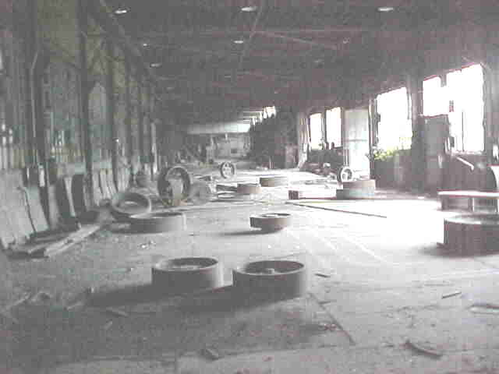
BROWNFIELDS
Real property,
the expansion,
redevelopment, or
reuse of which may
be complicated by the presence or potential presence of a hazardous substance, pollutant, or contaminant.
Small Business Liability Relief and Brownfields Revitalization Act
Public Law 107-118- January 11, 2002

Slide 6
Practical Faces of Brownfields
You’ll hear that EPA definition and other information again today
But to start off, let’s put a few real, ‘on the street’ faces on a few typical Midwestern Brownfields
  7 ‘everyday’ property scenarios
  Common types of property
  Some similar, but different funding eligibilities

Slide 7
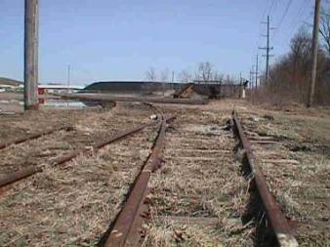
1. Active Rail Property
Owner: Shortline Railroad
Occupant: Active & abandoned rail areas, coal storage, mixed use
For Sale: Yes, a few preliminary failed deals by builders disinterested when they found it had been a rail area since late 1890s.
Assessed: No
Contaminated: Unknown, stigma of railroad use although no maintenance facilities, odd coloration from coal area.
Local Effect: City and nearby residents feel the riverfront location could be better used to serve the community to support a small hotel or parks property.

Slide 8
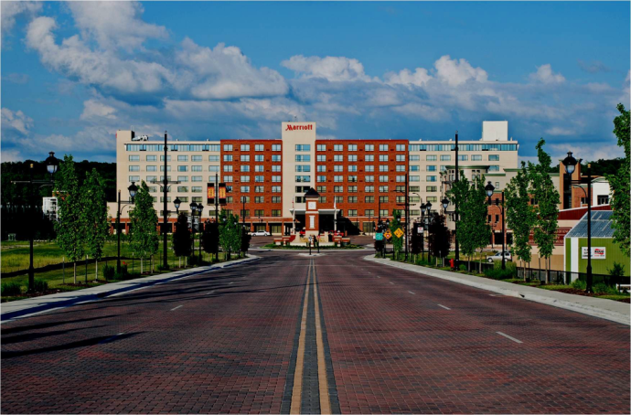
1. Active Rail Property
Owner: Shortline Railroad
Occupant: Active & abandoned rail areas, coal storage, mixed use
For Sale: Yes, a few preliminary failed deals by builders disinterested when they found it had been a rail area since late 1890s.
Assessed: No
Contaminated: Unknown, stigma of railroad use although no maintenance facilities, odd coloration from coal area.
Local Effect: City and nearby residents feel the riverfront location could be better used to serve the community to support a small hotel or parks property.
FUNDED

Slide 9
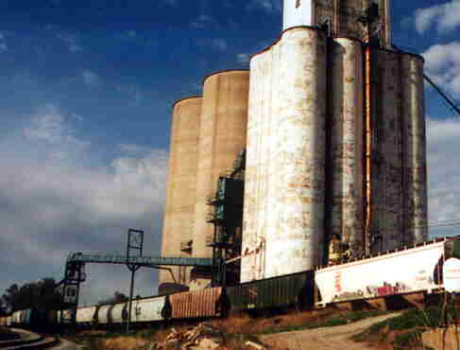
2. Grain Elevator
Owner: US Mills, LLC
Occupant: US Mills, LLC
For Sale: No
Assessed: No
Contaminated: Yes, City utility work identified chemical odors in soils laying new natural gas line. Reported to owner, status unknown.
Local Effect: USW is active, profitable and provides to the community approximately 30 jobs.

Slide 10
2. Grain Elevator
Owner: US Mills, LLC
Occupant: US Mills, LLC
For Sale: No
Assessed: No
Contaminated: Yes, City utility work identified chemical odors in soils laying new natural gas line. Reported to owner, status unknown.
Local Effect: USW is active, profitable and provides to the community approximately 30 jobs.
NOT
FUNDED
Does not meet the definition of Brownfields, site has a viable
responsible party … “the polluter still pays”. A grant could be used
on adjacent properties to allay public fears or clear for redevelopment.

Slide 11
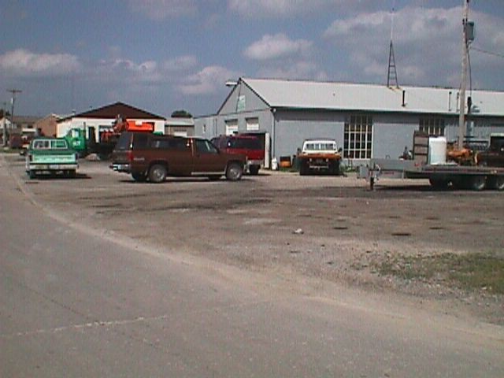
3. Former Rail Property
Owner: US Rail Co.
Occupant: No rail use. A few small businesses rent remaining siding buildings for storage, rest are vacant.
For Sale: Yes
Assessed: No
Contaminated: Unknown. No records of problems on file with state or EPA, but City told railroad properties can have environmental problems.
Local Effect: City would like to acquire and clear the property to expand for redevelopment opportunity for rail-based businesses.

Slide 12
3. Former Rail Property
Owner: US Rail Co.
Occupant: No rail use. A few small businesses rent remaining siding buildings for storage, rest are vacant.
For Sale: Yes
Assessed: No
Contaminated: Unknown. No records of problems on file with state or EPA, but City told railroad properties can have environmental problems.
Local Effect: City would like to acquire and clear the property to expand for redevelopment opportunity for rail-based businesses.
FUNDED
Abandoned and under-used with a perception the old land use may have caused problems.

Slide 13
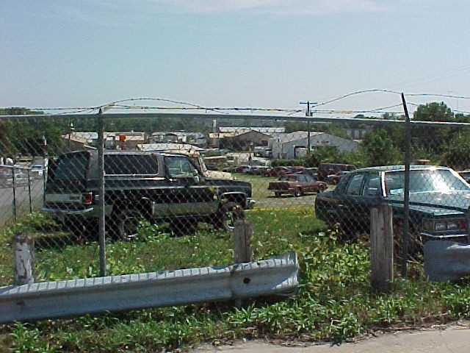
4. Former Gas Station
Owner: John Q. Gasman
Occupant: Abandoned and building demolished, used for parking.
For Sale: Yes
Assessed: Yes
Contaminated: Yes, active 2002 state leaking underground storage tank file shows gasoline in soils and groundwater.
Local Effect: Good corner location near to the downtown, could be better used to support tax base than as a parking lot.

Slide 14
4. Former Gas Station
Owner: John Q. Gasman
Occupant: Abandoned and building demolished, used for parking.
For Sale: Yes
Assessed: Yes
Contaminated: Yes, active state leaking underground storage tank file shows gasoline in soils and groundwater.
Local Effect: Good corner location near to the downtown, could be better used to support tax base than as a parking lot.
NOT
FUNDED
Alternate Funding: City purchased with due diligence after owner obtained minimal No Further Action for soils and restricted groundwater use and transferred with LUST Fund insurance policy. City accessed $450,000 to cleanup to higher and better use with voluntary cleanup program closure for protection of groundwater resources and resale to developers.

Slide 15
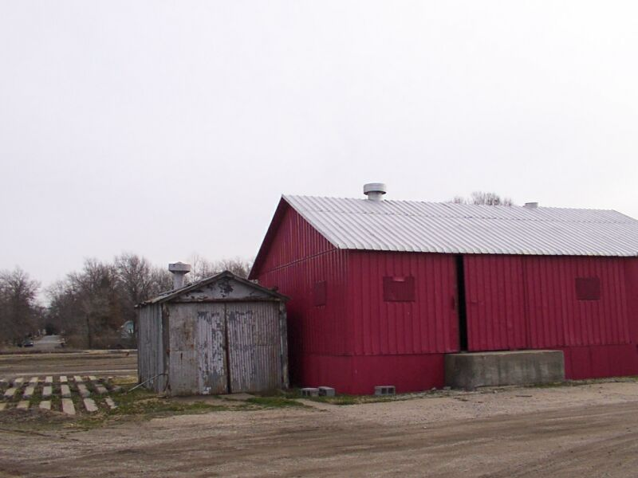
5. Former Fertilizer Storage
Owner: Good Grow, Inc.
Occupant: Abandoned 2002
Age: Built 1968
For Sale: Yes, Contract pending with community recycling group.
Assessed: No
Contaminated: Unknown. However, prospective purchaser is concerned that fertilizer storage and railroad operations may have impacted soils.
Local Effect: Perceived contamination has delayed sale and proposed redevelopment. Abandoned facility remains a nuisance and an hazard to area residents.

Slide 16
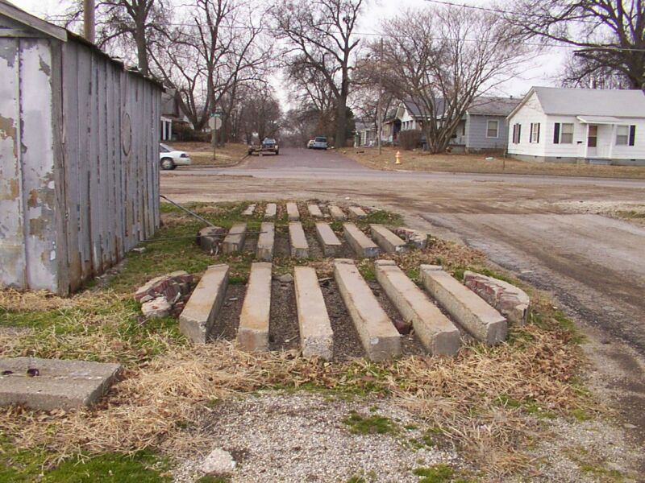
5. Former Fertilizer Storage
Owner: Good Grow , Inc.
Occupant: Abandoned 2002
Age: Built 1968
For Sale: Yes, Recycling center construction proposed. Sales contract pending.
Assessed: No
Contaminated: Unknown. However, prospective purchaser is concerned that fertilizer storage and railroad operations may have impacted soils.
Local Effect: Perceived contamination has delayed sale and proposed redevelopment. Abandoned facility remains a nuisance and a hazard to area residents.
FUNDED
Through State 128a

Slide 17
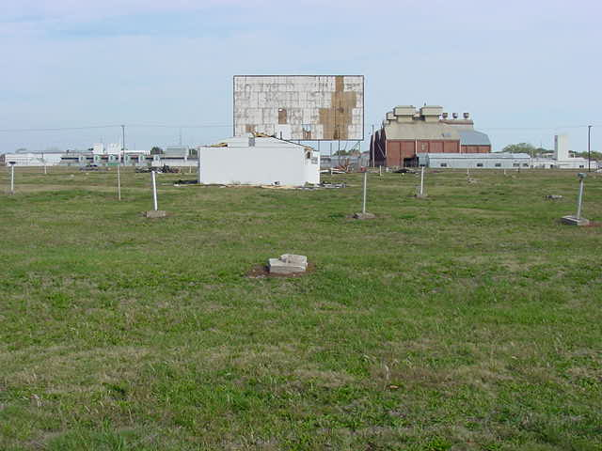
6. Former Drive-In Theater
Owner: Bubba’s Lawn and Entertainment, LLC
Occupant: Abandoned 1998
Age: Built 1952
For Sale: Yes, contract pending with school district.
Assessed: Yes, limited assessment under RCRA Permit for adjacent property
Contaminated: Unknown, previous assessment did not account for potential residential development
Local Effect: Perceived contamination diminished adjacent property values and prevented reuse. Demolition debris and abandoned buildings present hazards to children.

Slide 18
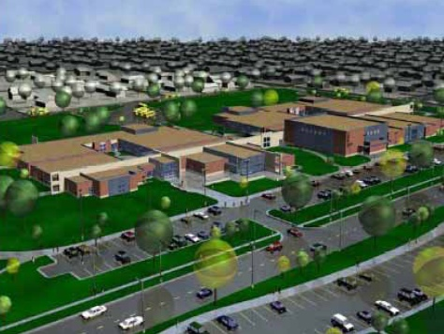
6. Former Drive-In Theater
Owner: Bubba’s Lawn and Entertainment, LLC
Occupant: Abandoned 1998
Age: Built 1952
For Sale: Yes, Contract pending with school district
Assessed: Yes, limited assessment conducted under RCRA Permit for adjacent property.
Contaminated: Unknown, previous assessment did not account for potential residential development.
Local Effect: Perceived contamination diminished adjacent property values and prevented reuse. Demolition debris and abandoned buildings present hazards to children.
FUNDED
Through State 128a
Eligible to assess unknowns, but not eligible to address known impacts from the RCRA facility for the responsible party.

Slide 19
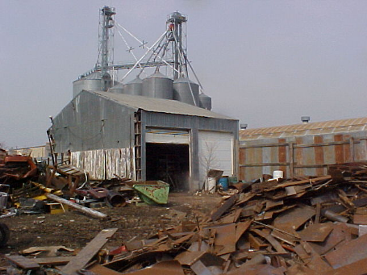
7. Metals Scrapyard
Owner: Good Ol’ Boy Metals
Occupant: Occupied/Active
For Sale: Potentially
Assessed: No
Contaminated: Unknown, but commercial metal salvage operations known to have environmental problems.
Local Effect: City needs to purchase property for street and utility realignments and to improve gateway aesthetics. Not sufficient project value or demonstrated need for condemnation.

Slide 20
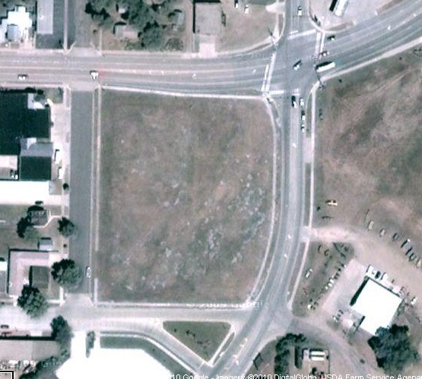
7. Metals Scrapyard
Owner: Good Ol’ Boy Metals
Occupant: Occupied/Active
For Sale: Potentially
Assessed: No
Contaminated: Unknown, but commercial metal salvage operations known to have environmental problems.
Local Effect: City needs to purchase property for street and utility realignments and to improve gateway aesthetics. Not sufficient project value or demonstrated need for condemnation.
FUNDED

Slide 21

Brownfields are Opportunity
“Opportunity is not recognized by most people when they meet, because it is usually dressed in overalls and looks like work.”
Thomas Alva Edison

Slide 22
THANK YOU
Brownfield Services
Serving clients through more than 120 U.S. offices
Dave Koch, Senior Principal / Senior Consultant
National Brownfields Program
dekoch@terracon.com
www.terracon.com
800.599.6886

