Slide 1
The TAB Program Technical Assistance to Brownfields
Wendy Griswold, Ph.D.
Center for Hazardous Substance Research
Kansas State University
September 2012

Slide 2
Overview of this Presentation
TAB Program Overview:
What we do
Effective community involvement strategies
How BIT & TABEZ software can help
http://www.engg.ksu.edu/CHSR/outreach/tab/workshops/2012BF_Madison_WI.html
Notes:
Ask ? At any time
Invite input from EPA

Slide 3
Technical Assistance to Brownfield (TAB) Communities
A national program
Funded by EPA headquarters via grants to 4 different entities
Free to communities
K-State assists communities in EPA Regions 5 and 7

Slide 4
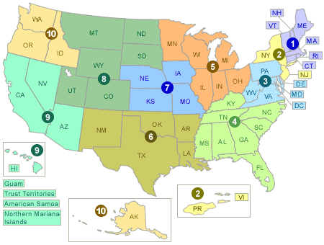
EPA Regions

Slide 5
TAB Assistance to Communities
Tailored to specific community needs
Typically coordinated through the city, tribal or non-profit brownfields project manager.
Communities accepted on a ‘first come’ basis
Depends on staff/funding availability
K-State Staff and Subcontractors

Slide 6
Areas of TAB Services
Understanding brownfields law & incentives
Identifying funding options
Finding a consulting firm
Identifying Brownfields and limited inventories
Reviewing reports and plans
Redevelopment planning/Visioning sessions
Community outreach and education
Notes:
Give specific examples – educational presentations, rfp, understanding the data you get from the consultants

Slide 7
The Application Process
Contact us
We’ll set up a meeting to discuss assistance needs
Review needs and TAB capability
Agree on a course of action
Get started

Slide 8
Community Involvement
Who is the Community?
Why do it?
Notes:
Who – you define that. People and organizations that have a stake in any given issue or project. Live in, operate business in or adjacent to BF - minimum
Why?
Building community = resilient communities
Community support is integral to project success
It’s a requirement with high expectations
How? See next slide

Slide 9
Community Involvement Tools
Workshops/Training Sessions
Tailored to the information needs of the community
Keep audience awake and engaged
Relaxed atmosphere
Time for networking
Variety of presenters
Hands-on segments
Very effective !
Notes:
Tell me and I forget
Teach me and I remember
Involve me and I learn
Ben Franklin quote

Slide 10
Community Involvement Tools
Redevelopment Planning
Notes:
Expectation that community will be involved in making decisions and giving input into what BF are redeveloped into.

Slide 11
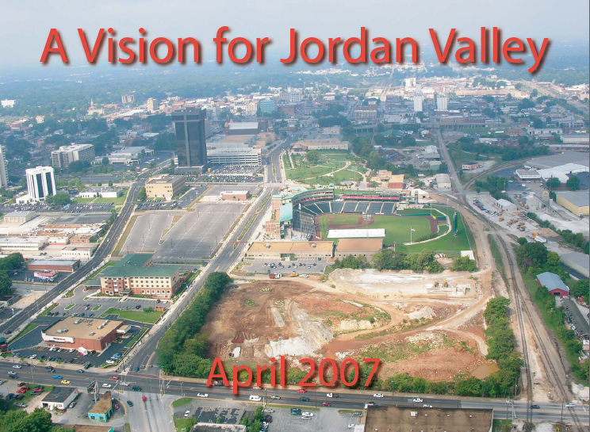
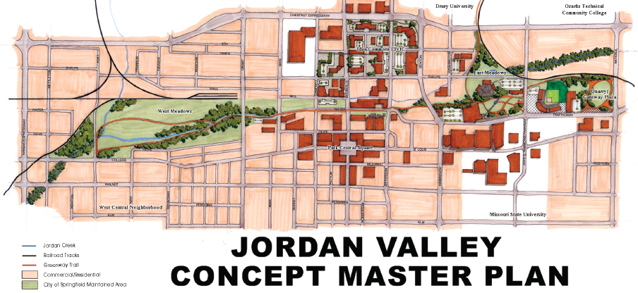
Importance of Redevelopment Planning Process
Vision development
Stakeholder coordination
Eligibility for incentives
Long-term Implementation
City of Springfield, MO Missouri

Slide 12
Visioning
Notes:
Visioning sessions are great avenues for public to be involved in redevelopment planning. Opportunity to create a picture or vision of what is possible for a site.
Great way to learn from a community about site history, local needs.

Slide 13
Visioning
Notes:
You can see that visioning is a very hands-on and interactive activity. Builds community as well as helps meet project goals and expectations.

Slide 14
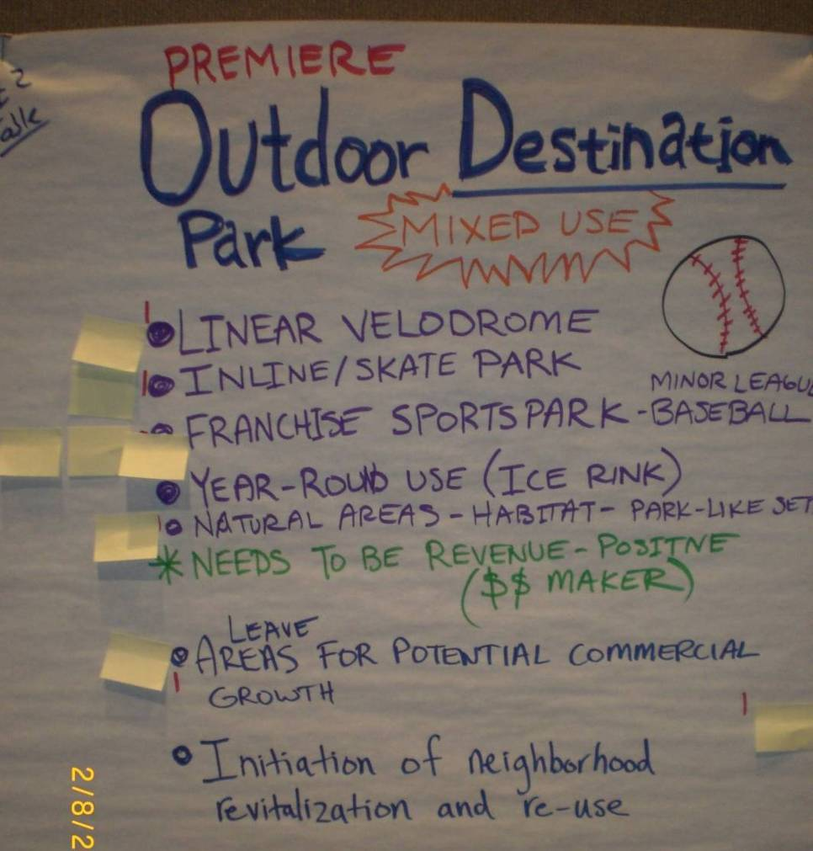
Visioning
Notes:
Example of what ideas were produced at a visioning session

Slide 15
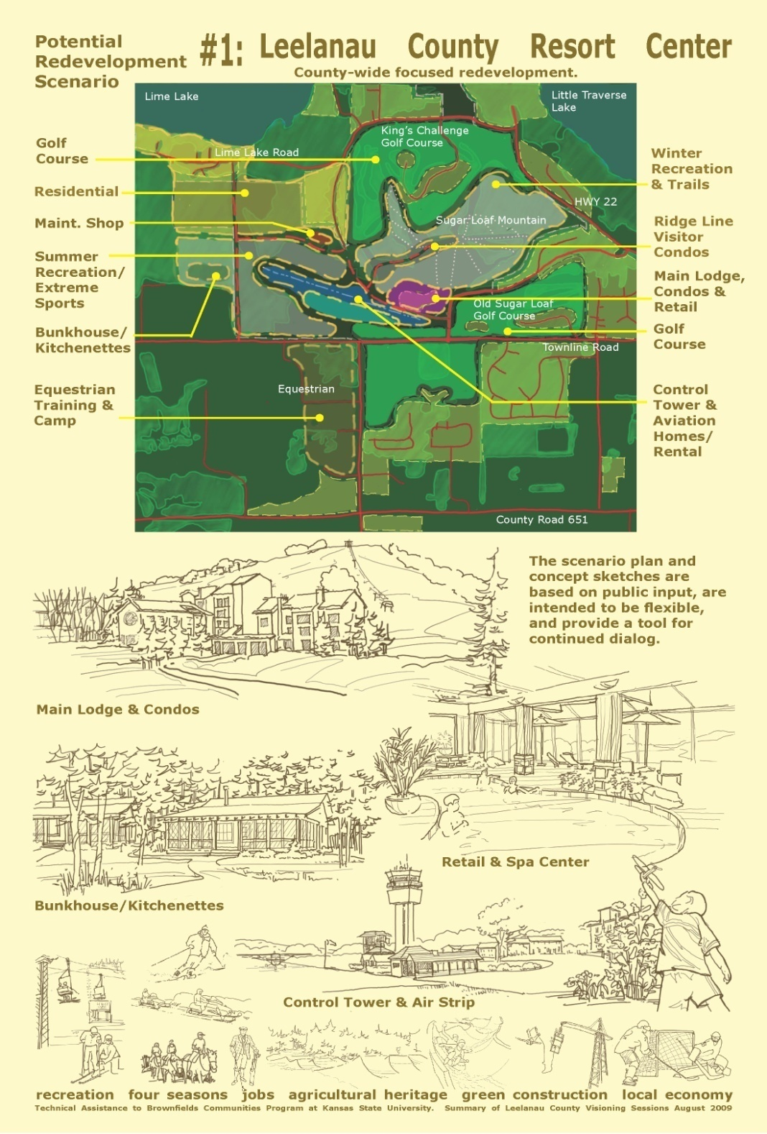
Visioning Output
Conceptual rendering capturing main ideas
Notes:
What is the end result of visioning.
Can be a written document, but creating an image is more effective and useful. Need to involve planners or architects to render info from previous slide into something like this.
Vision statement for formal adoption is also an outcome. Shows commitment and public support of ideas.

Slide 16
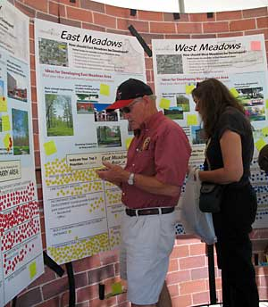
Additional Community Involvement Tools
Fact Sheets & News Releases
Public Meetings
Workshops/Seminars
Community Day/Fairs
Bus Tours
Walking Tours
Source: City of Springfield, MO

Slide 17
Fact Sheets, Citizen Briefs
clear
concise
in layman’s terms
basic information
provide contact info and additional resources
Note: NOT a stand-alone tool

Slide 18
TAB Website (http://www.engg.ksu.edu/chsr/outreach/tab/)

Slide 19
Technical Presentations
Community Meetings

Slide 20
Tools to Help with BF Proposals
TAB BIT
Brownfields Inventory Tool
TAB EZ
Proposal Development Software

Slide 21
BIT (Brownfields Inventory Tool)
www.tab-bit.org
Stores & Manages Data:
Site survey & inventory
Assessment, cleanup, and redevelopment progress
Public notice records
Oversight & enforcement
Reporting

Slide 22
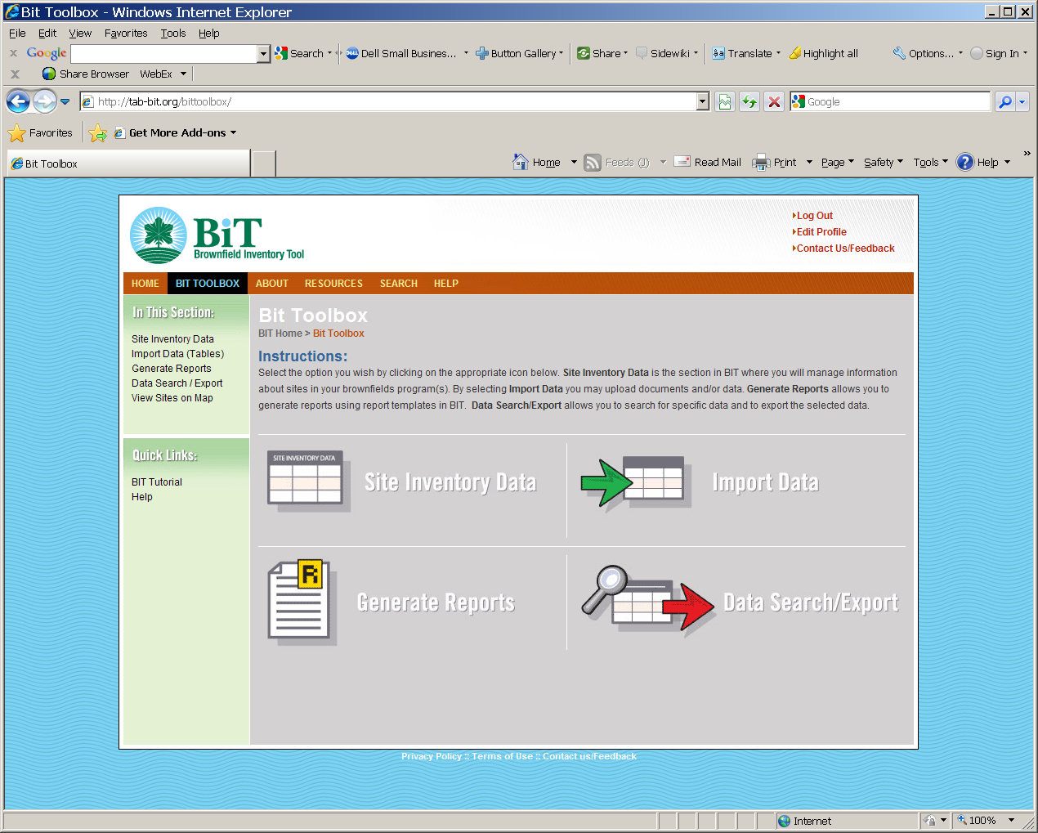
BIT (Brownfields Inventory Tool)
Structure Mirrors the Brownfields Redevelopment Process
Site Identification
Assessment & Sampling
Cleanup
Institutional/ Engineering Controls
Redevelopment/Re-use

Slide 23
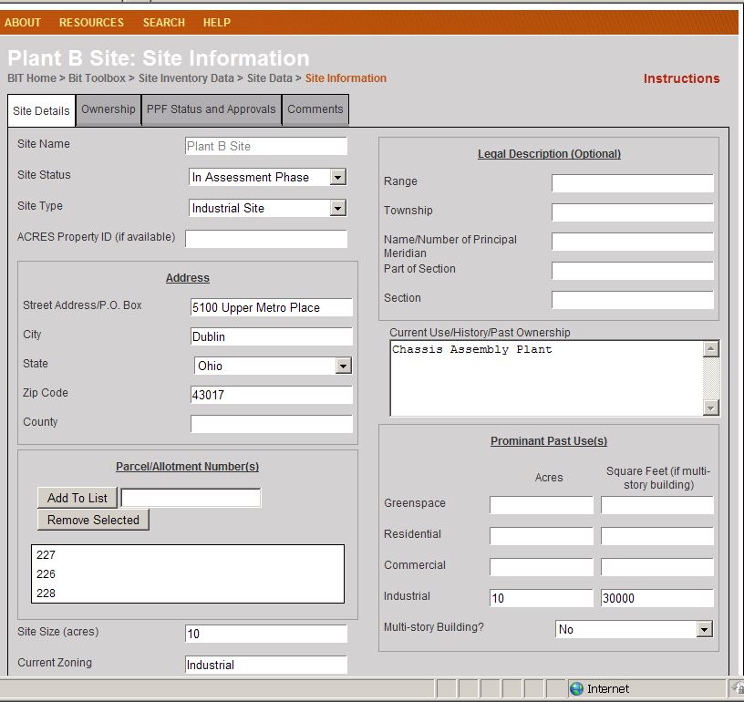
BIT (Brownfields Inventory Tool)
Start using before writing grants
Then use to show progress and plans in proposals, for:
Survey and inventory of potential brownfields
Site statistics in area
Priorities for assessment, cleanup, and redevelopment

Slide 24
TAB EZ – A Grant Writing Tool
Free tool to assist in writing EPA brownfields assessment and cleanup grant applications
Lots of support and helpful hints
www.tabez.org

Slide 25
Web - based software for Assessment and Cleanup Grants: www.tabez.org

Slide 26
Features and Benefits to Users
User friendly and can be accessed anytime at the user’s own pace
Integrates Brownfield education with online support: definitions, regulatory citations and pertinent federal/state web links
Helpful Hints for every criteria to be addressed

Slide 27
TAB Contacts
Blase Leven (Program Coordinator)
785-532-0780 baleven@ksu.edu
Dr. Wendy Griswold
(785) 691-7192
griswold@ksu.edu
Terrie Boguski
(913) 780-3328
boguski@ksu.edu
Web site: http://www.engg.ksu.edu/CHSR/outreach/tab/index.html

