Slide 1
WHAT IS A BROWNFIELD…..
AND DO I HAVE ONE?
Prepared for…
Brownfields Resources and Partners
TAB/Ball State University Brownfields Workshop
September 2, 2010: Indianapolis, Indiana
Prepared by…Beth A. Grigsby, LPG
ATC Associates, Inc. beth.grigsby@atcassociates.com
Notes:
NAVIGATION & PRESENTATION EDITING TIPS: (Print this Notes Page)
This overview presentation has been created to give the presenter the greatest opportunity for message customization on-the-fly. Present only as much information as relevant for your target audience. Encourage interaction at every opportunity.
Slide 1-5 These slides demonstrate grasp of your understanding of issues impacting their organizations. Also, you’re
underscoring the issues in play when needed action is delayed or avoided.
Slide 6 Use this slide as a facilitation mechanism. Stop. Interact.
Slide 7 Primary Navigation Screen – Click on any relevant links based on your discussion in slide #6. Make your
presentation as short or long as needed. Click on the SUMMARY link (located throughout the presentation) to
go to the final closing slides.
Slides 8-11 Construction Engineering, Testing & Inspection Section
Slides 12-15 Business Operations Section
Slides 16-19 Facility Management Section
Slides 20-23 Expansion & Renovation Section
Slides 24-27 Real Estate Purchase, Finance & Sale Section
Slides 28-32 Summary Slides
EDITING TIPS -
Replace text wherever desired but try to avoid adding more lines of text or causing existing text to wrap to a second line.
Add slides where necessary. The easiest way is to simply select INSERT-DUPLICATE from the slide you want to emulate
and edit/delete the text in that duplicate slide as needed.
The slide #7 hyperlinks will always go to the same target page – even if their slide number has changed because of inserted slides
Try to follow existing formatting. (Single lines of text. Sentence-type capitalization for body text. Labels/title initial cap each word)
When inserting other images – Use only quality imagery.

Slide 2
Brownfield Redevelopment What’s all the Hype?
EXPANSION, REUSE, OR REDEVELOPMENT OF
BROWNFIELD SITES:
Increase (RENEWS) property value and local tax base
Reduce the need to develop greenfields
Uses existing infrastructure (cost savings)
Mitigates public health and safety concerns
Improves the community image

Slide 3
What is a Brownfield?
“…..real property, the expansion, redevelopment, or
reuse of which may be complicated by the presence
or potential presence of a hazardous substance, pollutant or contamination.” (US EPA)
States vary in definitions
Most contain low to moderate levels of contamination
Can address asbestos, lead paint, meth lab contaminants and mine-scarred lands
Notes:
By law the definition expanded to included land contaminated by petroleum or petroleum products, land contaminated by controlled substances (meth-labs) and mine-scarred land.

Slide 4

DRILL DOWN
REAL PROPERTY
EXPANSION, REDEVELOPMENT OR REUSE
POTENTIAL TO CONTAIN
  CONTAMINATION

Slide 5
BROWNFIELDS PROGRAM DOES NOT
BENEFIT THE PRP…
REPEAT AGAIN…
DOES NOT BENEFIT THE PRP (POTENTIALLY RESPONSIBLE PARTIES)
GENERAL EXAMPLES OF SITES NOT ELIGIBLE FOR FUNDING:
  LOCAL GOVERNMENT OWNED/OPERATED GARAGES, LANDFILLS
  LAND IS PURCHASED VOLUNTARILY BY THE LOCAL COMMUNITY
  QUESTIONS ABOUT ELIGIBILITY SHOULD BE DIRECTED TO INDIANA
  BROWNFIELDS PROGRAM OR EPA CAN ASSIST YOU IN DETERMINATION
  BROWNFIELD RESOURCES CANNOT BE USED TO BENEFIT THE POLLUTER!!

Slide 6


GETTING STARTED…
IDENTIFY SUSPECTED AREAS
IDENTIFY STAKEHOLDERS
REVIEW THE COMMUNITY’S PLAN FOR TARGETED AREAS-WHAT’S THE BIG PICTURE

Slide 7
THE COMMUNITY DEFINES ITS BROWNFIELDS
EPA provides the guidance, but it is the community that identifies a property as a Brownfield
Abandoned property
Active but Underutilized
Real estate turnover complicated by real or perceived contamination
Property use Blighted –significantly conflicts with a master plan

Slide 8

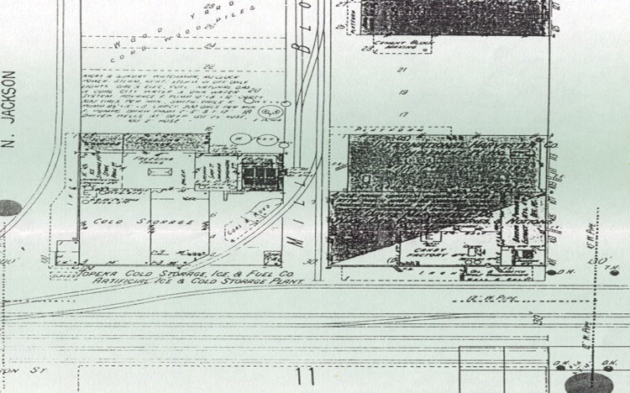
IDENTIFICATION: Tour your community!
If community wide…visit the local library and/or County Seat
Visit with your stakeholders: neighborhood groups, chambers, church groups, local planners, private corporations, real estate and economic development interests
Review Topographic maps, local and State maps
Talk with local historians

Slide 9

IDENTIFICATION: Tour your community!
If a coalition…identify your coalition members and develop a strategy for identification
Draw upon your regional plan to identify sites in targeted areas
Ask coalition members to visit with their stakeholders for an inventory
Refer to previous slide for next steps

Slide 10

IDENTIFICATION
SITES THAT ALREADY IN TARGETED AREAS WITH OTHER RESOURCES (FEDERAL, STATE, COUNTY, LOCAL):
  RANK HIGHER FOR FUNDING
  MAKE SENSE TO TAXPAYERS

Slide 11
IDENTIFICATION
May or may not be obvious:
  Abandoned property
  Active but Underutilized
  Real estate turnover complicated by real or perceived contamination
  Property use Blighted –significantly conflicts with a master plan
Meet with local and state agency representatives:
  Local and State Environmental Agencies
  Local and State Health Departments
  Local Police and Fire Departments
  Local Planning Officials
  Local Public Works Officials
Notes:
State and local maps State and local maps offer a broad spectrum of information, such as zoning codes, master plans, topography, water table levels, and aquifer locations.
These maps can help you examine several brownfields issues, such as remediation and site reuse options. Contact your local and/or State planning departments for more information on these maps.
Discuss the historical uses with owner/neighbors
Review state/local maps
Review old Fire Insurance maps (Sanborns)
Check with Health Department, Police and Fire departments Building and zoning records
Check State Department of Environmental Quality records
Check EPA web site – www.epa.gov
Check with local planners

Slide 12
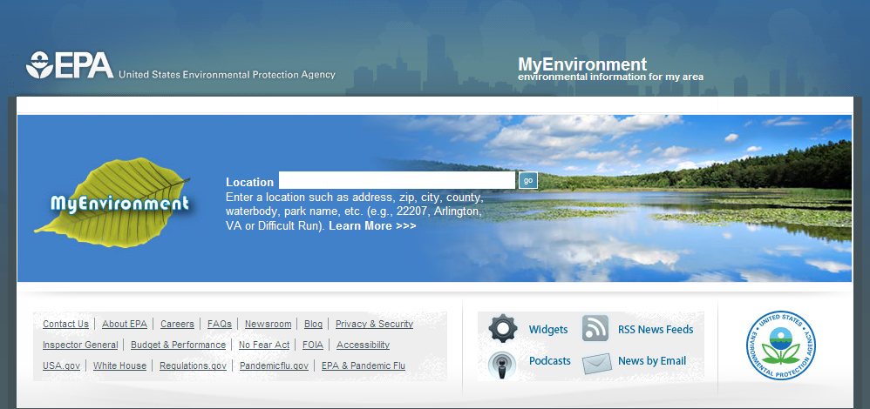
INTERACTIVE PROGRAM FEATURING FEDERAL REGULATORY DATA ON SITES
www.epa.gov/myenvironment/

Slide 13
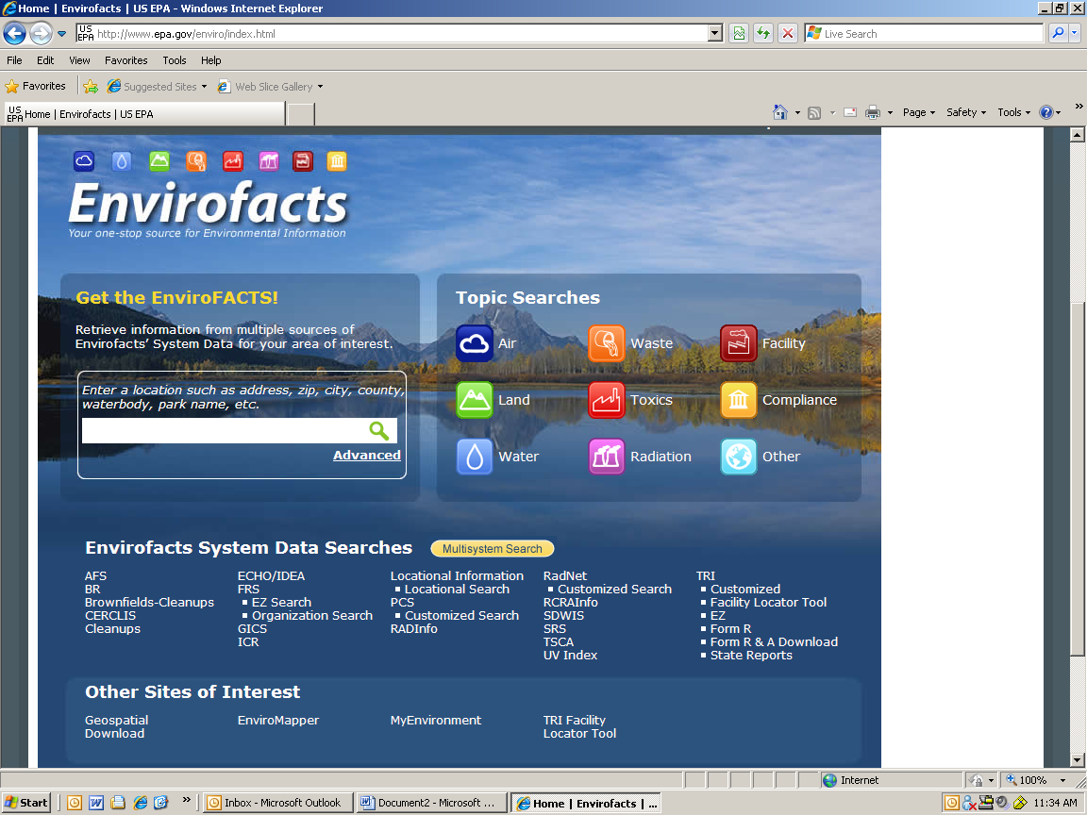
MORE FEDERAL REGULATORY DATA…
www.epa.gov/enviro/index.html

Slide 14
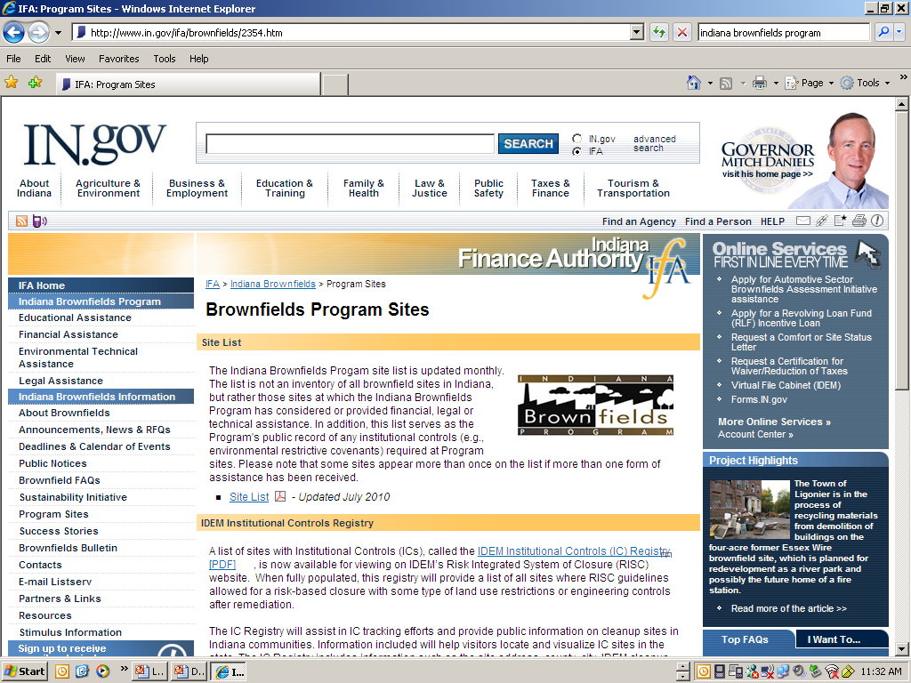
IN BROWNFIELDS PROGRAM SITES,
RESOURCES, FAQs
www.in.gov/ifa/brownfields/2354.htm

Slide 15
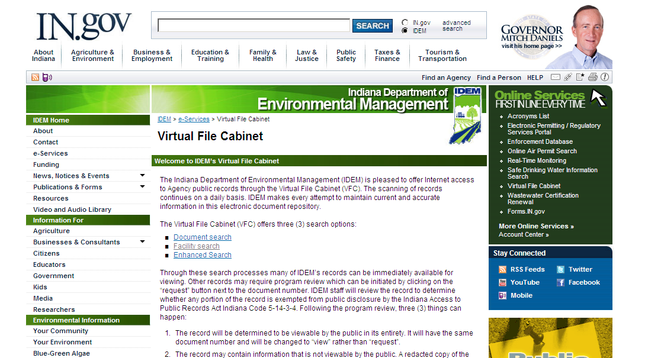
IDEM’s VIRTUAL FILE CABINET
www.in.gov/idem/6551.htm

Slide 16





WHEN CONSIDERING STAKEHOLDERS…CONSIDER WHO MIGHT BENEFIT FROM CLEANUP

Slide 17
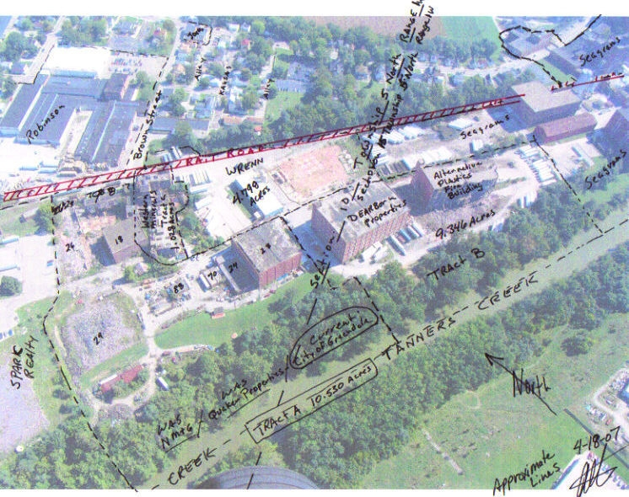
WHAT’S THE BIG PICTURE?

Slide 18
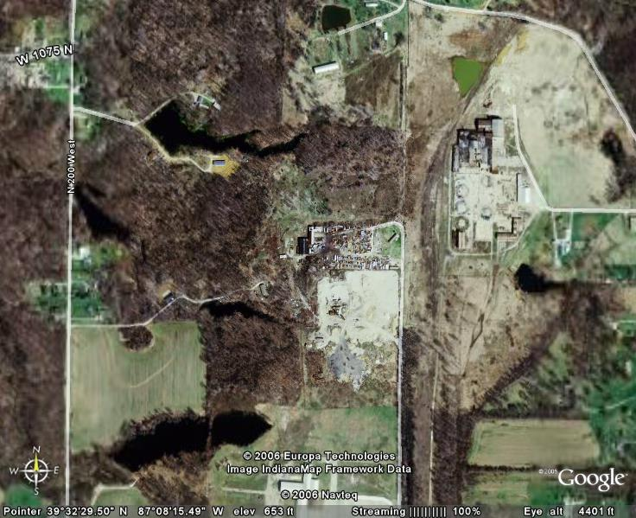
CHECK YOUR COMPREHENSIVE PLAN FOR
LAND USE CONFLICTS

Slide 19
DRILL DOWN
REAL PROPERTY
EXPANSION, REDEVELOPMENT OR REUSE
POTENTIAL TO CONTAIN
  CONTAMINATION

Slide 20
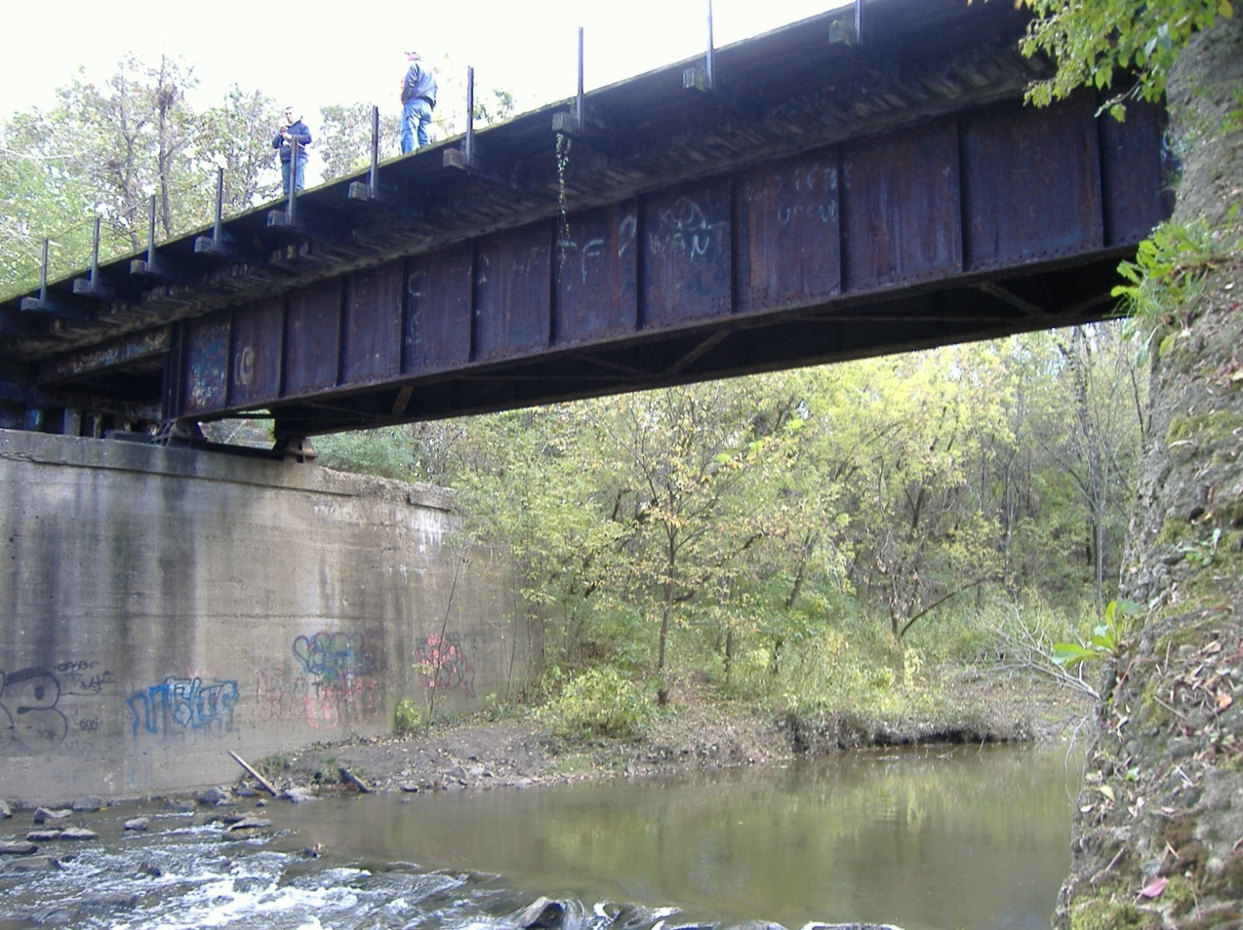
BROWNFIELD? GREENWAYS, TRAILS
REAL PROPERTY?
POTENTIAL FOR CONTAMINATION?
REUSE?
LOGICAL STAKEHOLDERS?

Slide 21
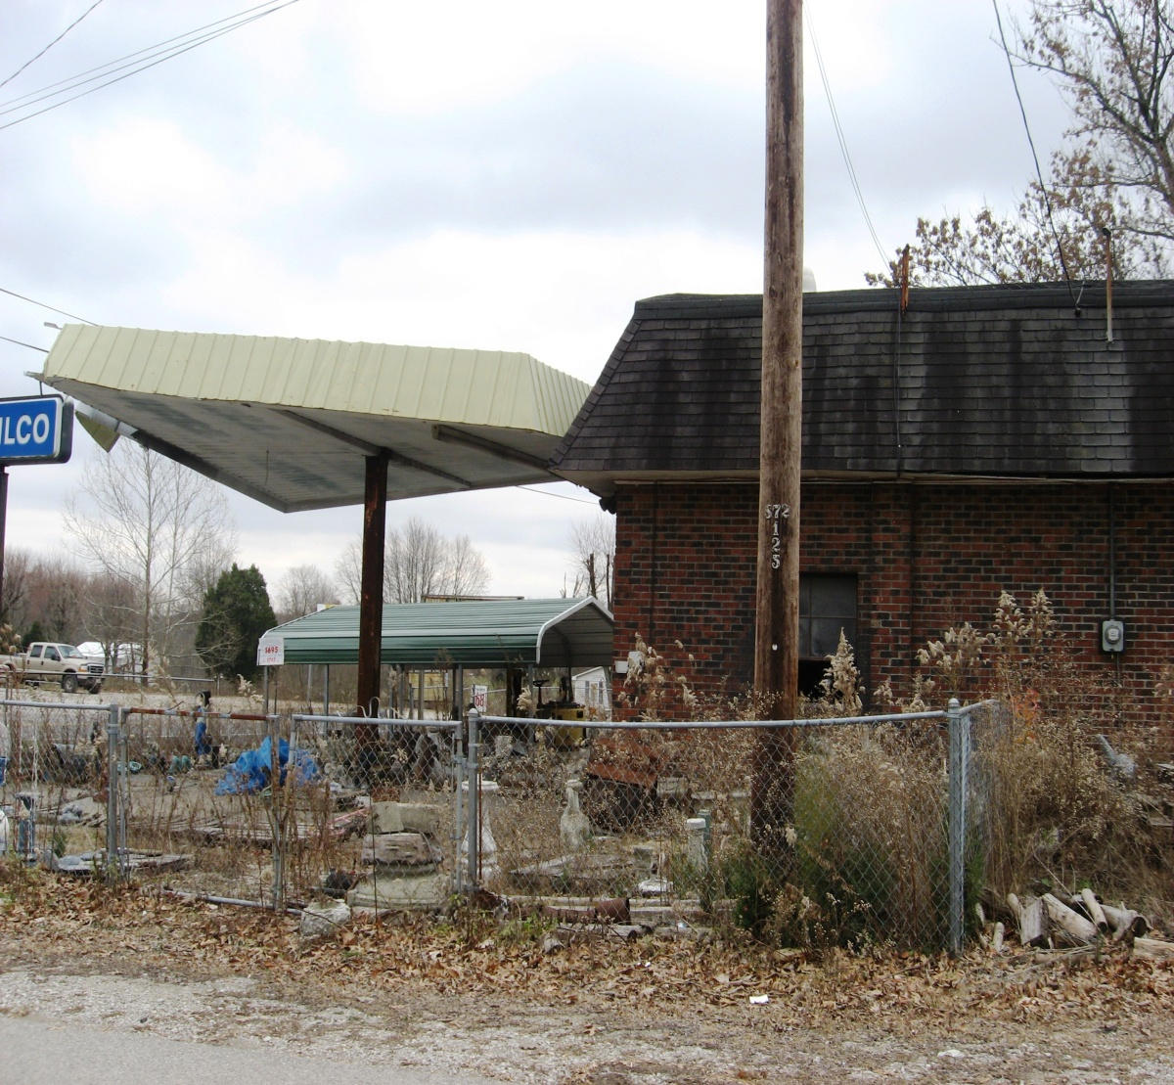
REAL PROPERTY, POTENTIAL FOR CONTAMINATION
EXPANSION,
REUSE
REDEVELOPMENT
PLAN???

Slide 22
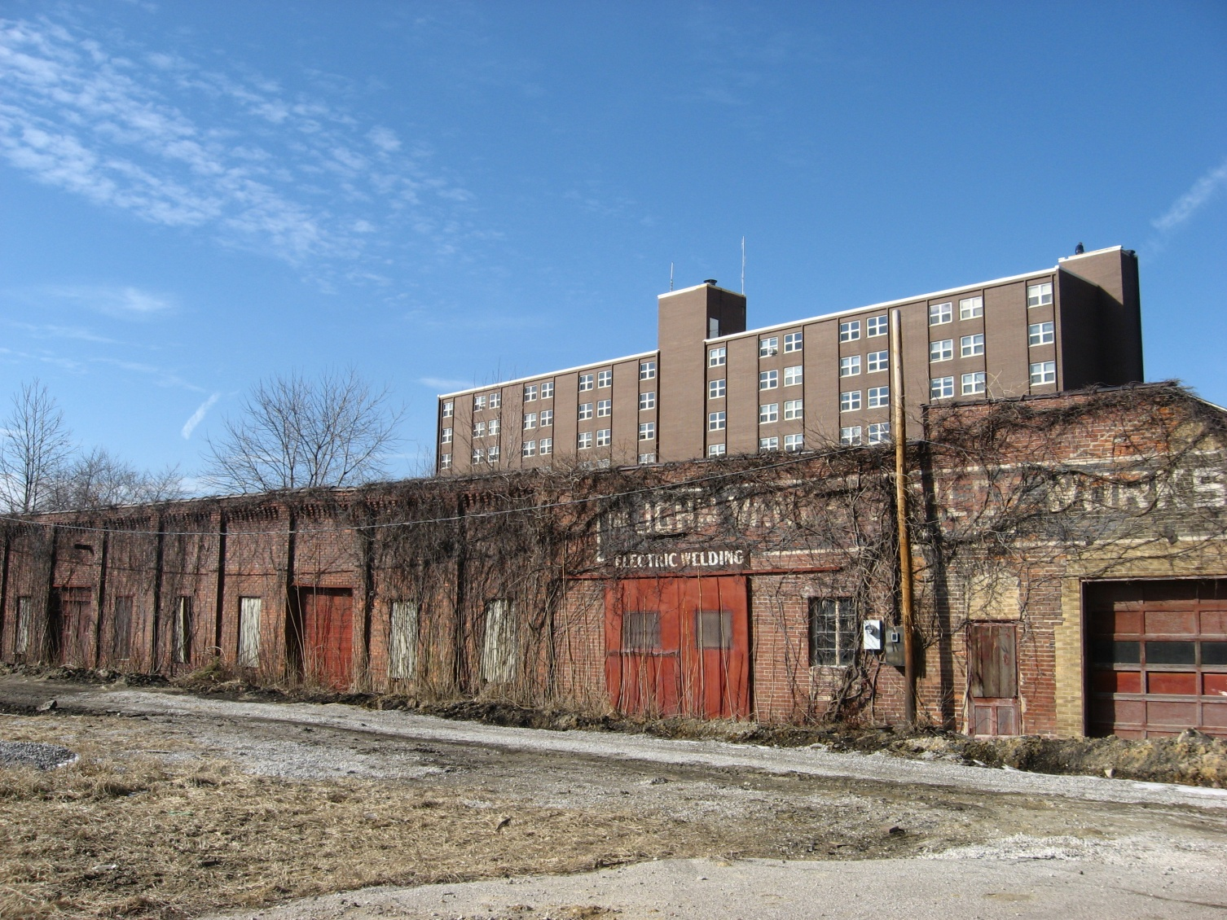
ABANDONED BUILDING NEXT TO COMMUNITY HOUSING PROJECT
POTENTIAL FOR
CONTAMINATION
REAL PROPERTY?
REUSE?
STAKEHOLDERS?

Slide 23
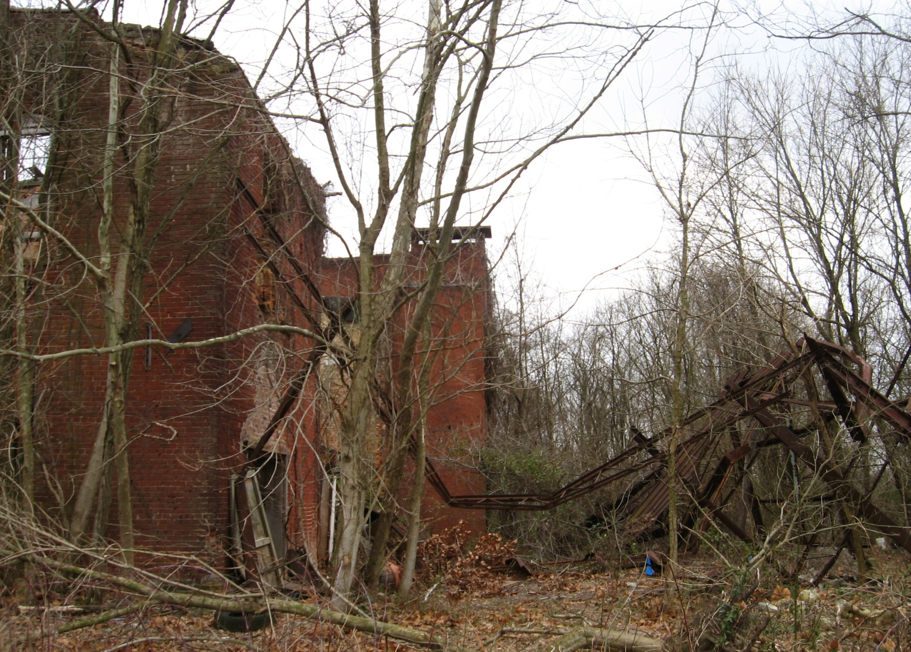
OLD SCHOOL
REAL PROPERTY
POTENTIAL FOR
CONTAMINATION
REUSE PLAN?

Slide 24
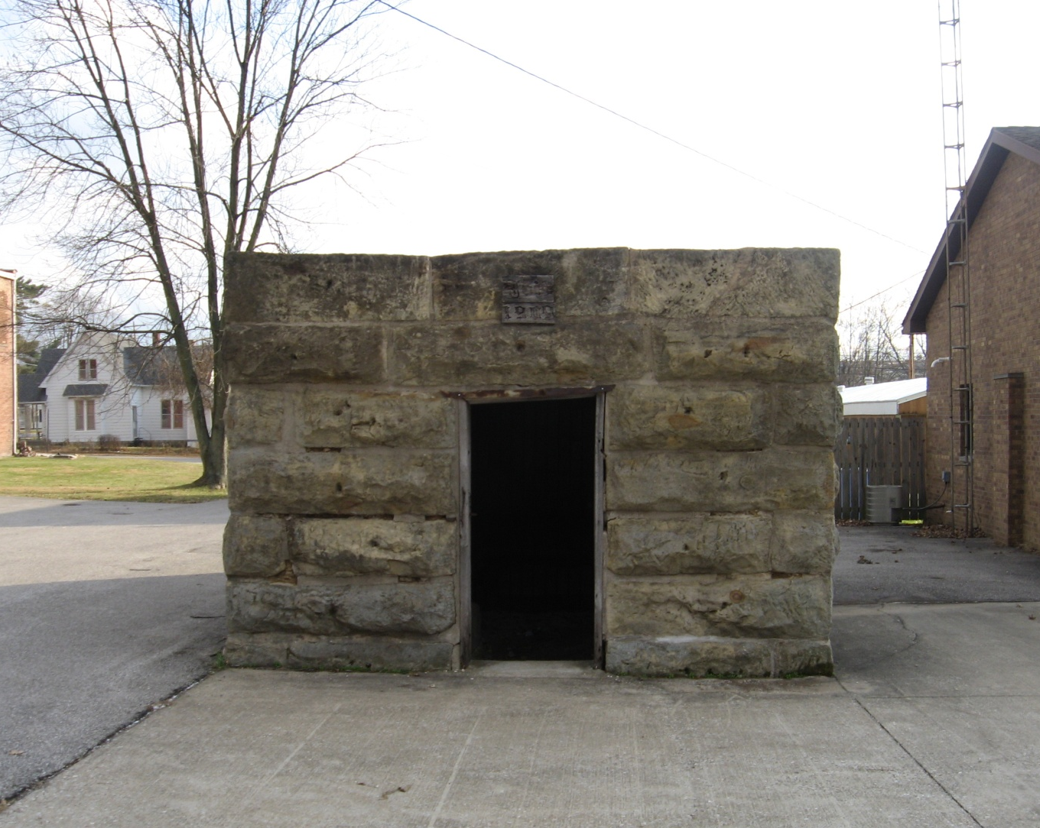
HISTORIC CITY JAIL—BROWNFIELD???
REAL PROPERTY
REUSE PLAN
POTENTIAL FOR CONTAMINATION

Slide 25
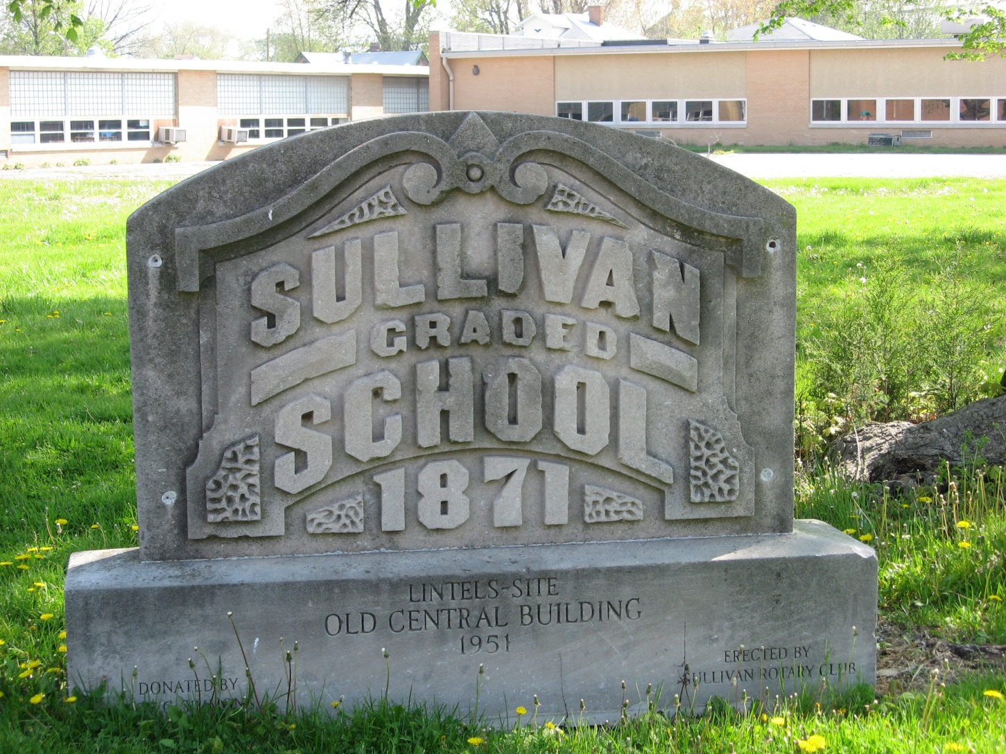
OLD GRADE SCHOOL—BROWNFIELD??
REAL PROPERTY
POTENTIAL CONTAMINATION
REUSE PLAN?

Slide 26
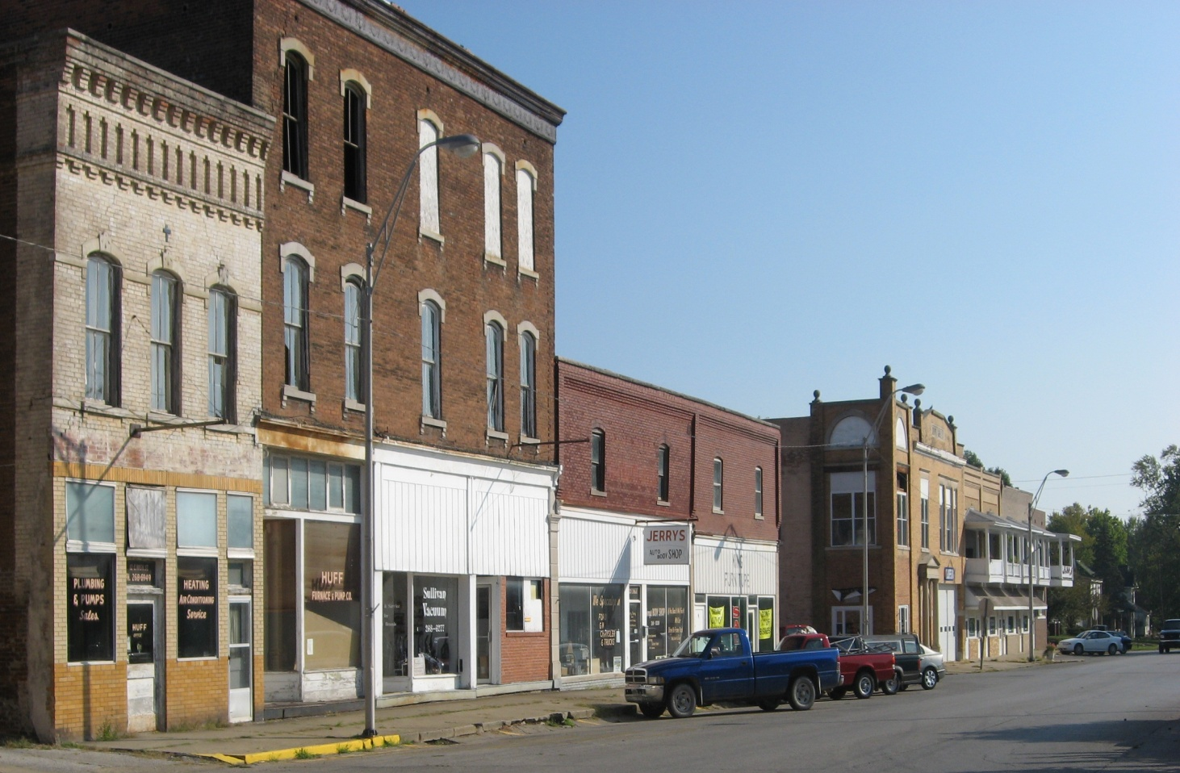
MAIN STREET BUILDINGS—BROWNFIELD?
REAL PROPERTY
POTENTIAL FOR CONTAMINATION
REUSE PLAN

Slide 27
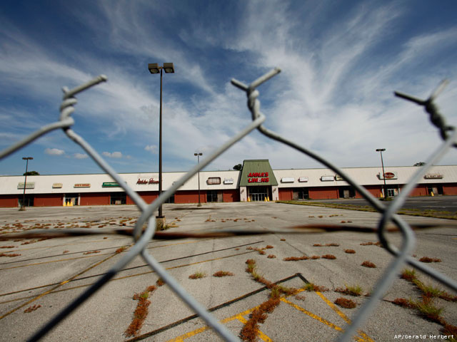
OUTDATED STRIP MALLS—BROWNFIELD?

Slide 28
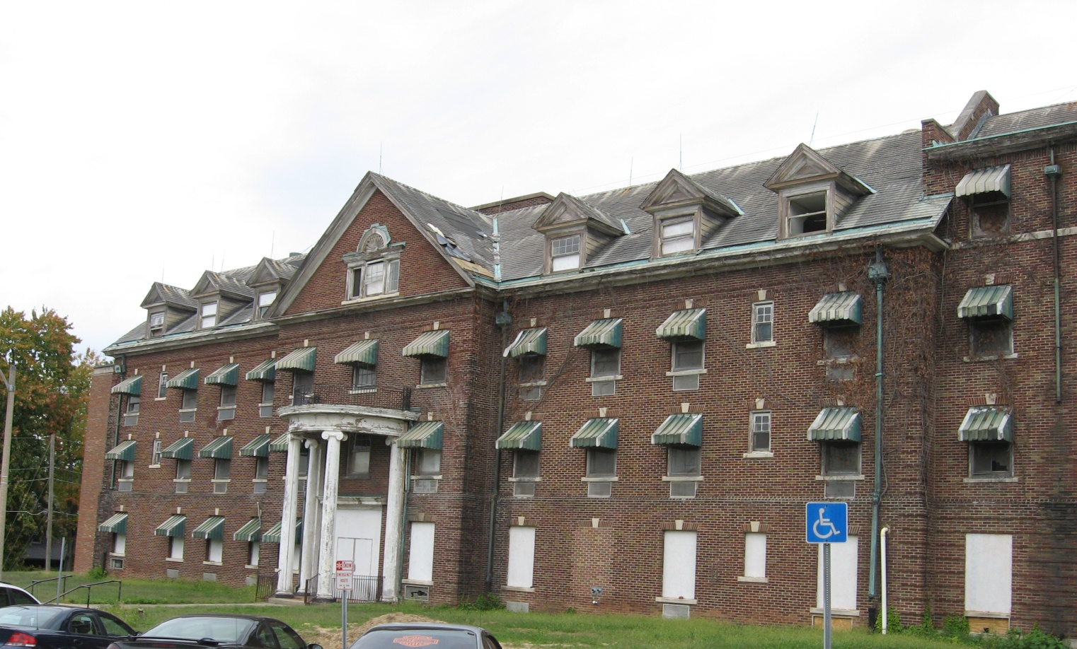
OLD COUNTY HOSPITAL (HISTORIC) ---BROWNFIELD?
REAL PROPERTY
CONTAMINATION?
REUSE PLAN

Slide 29
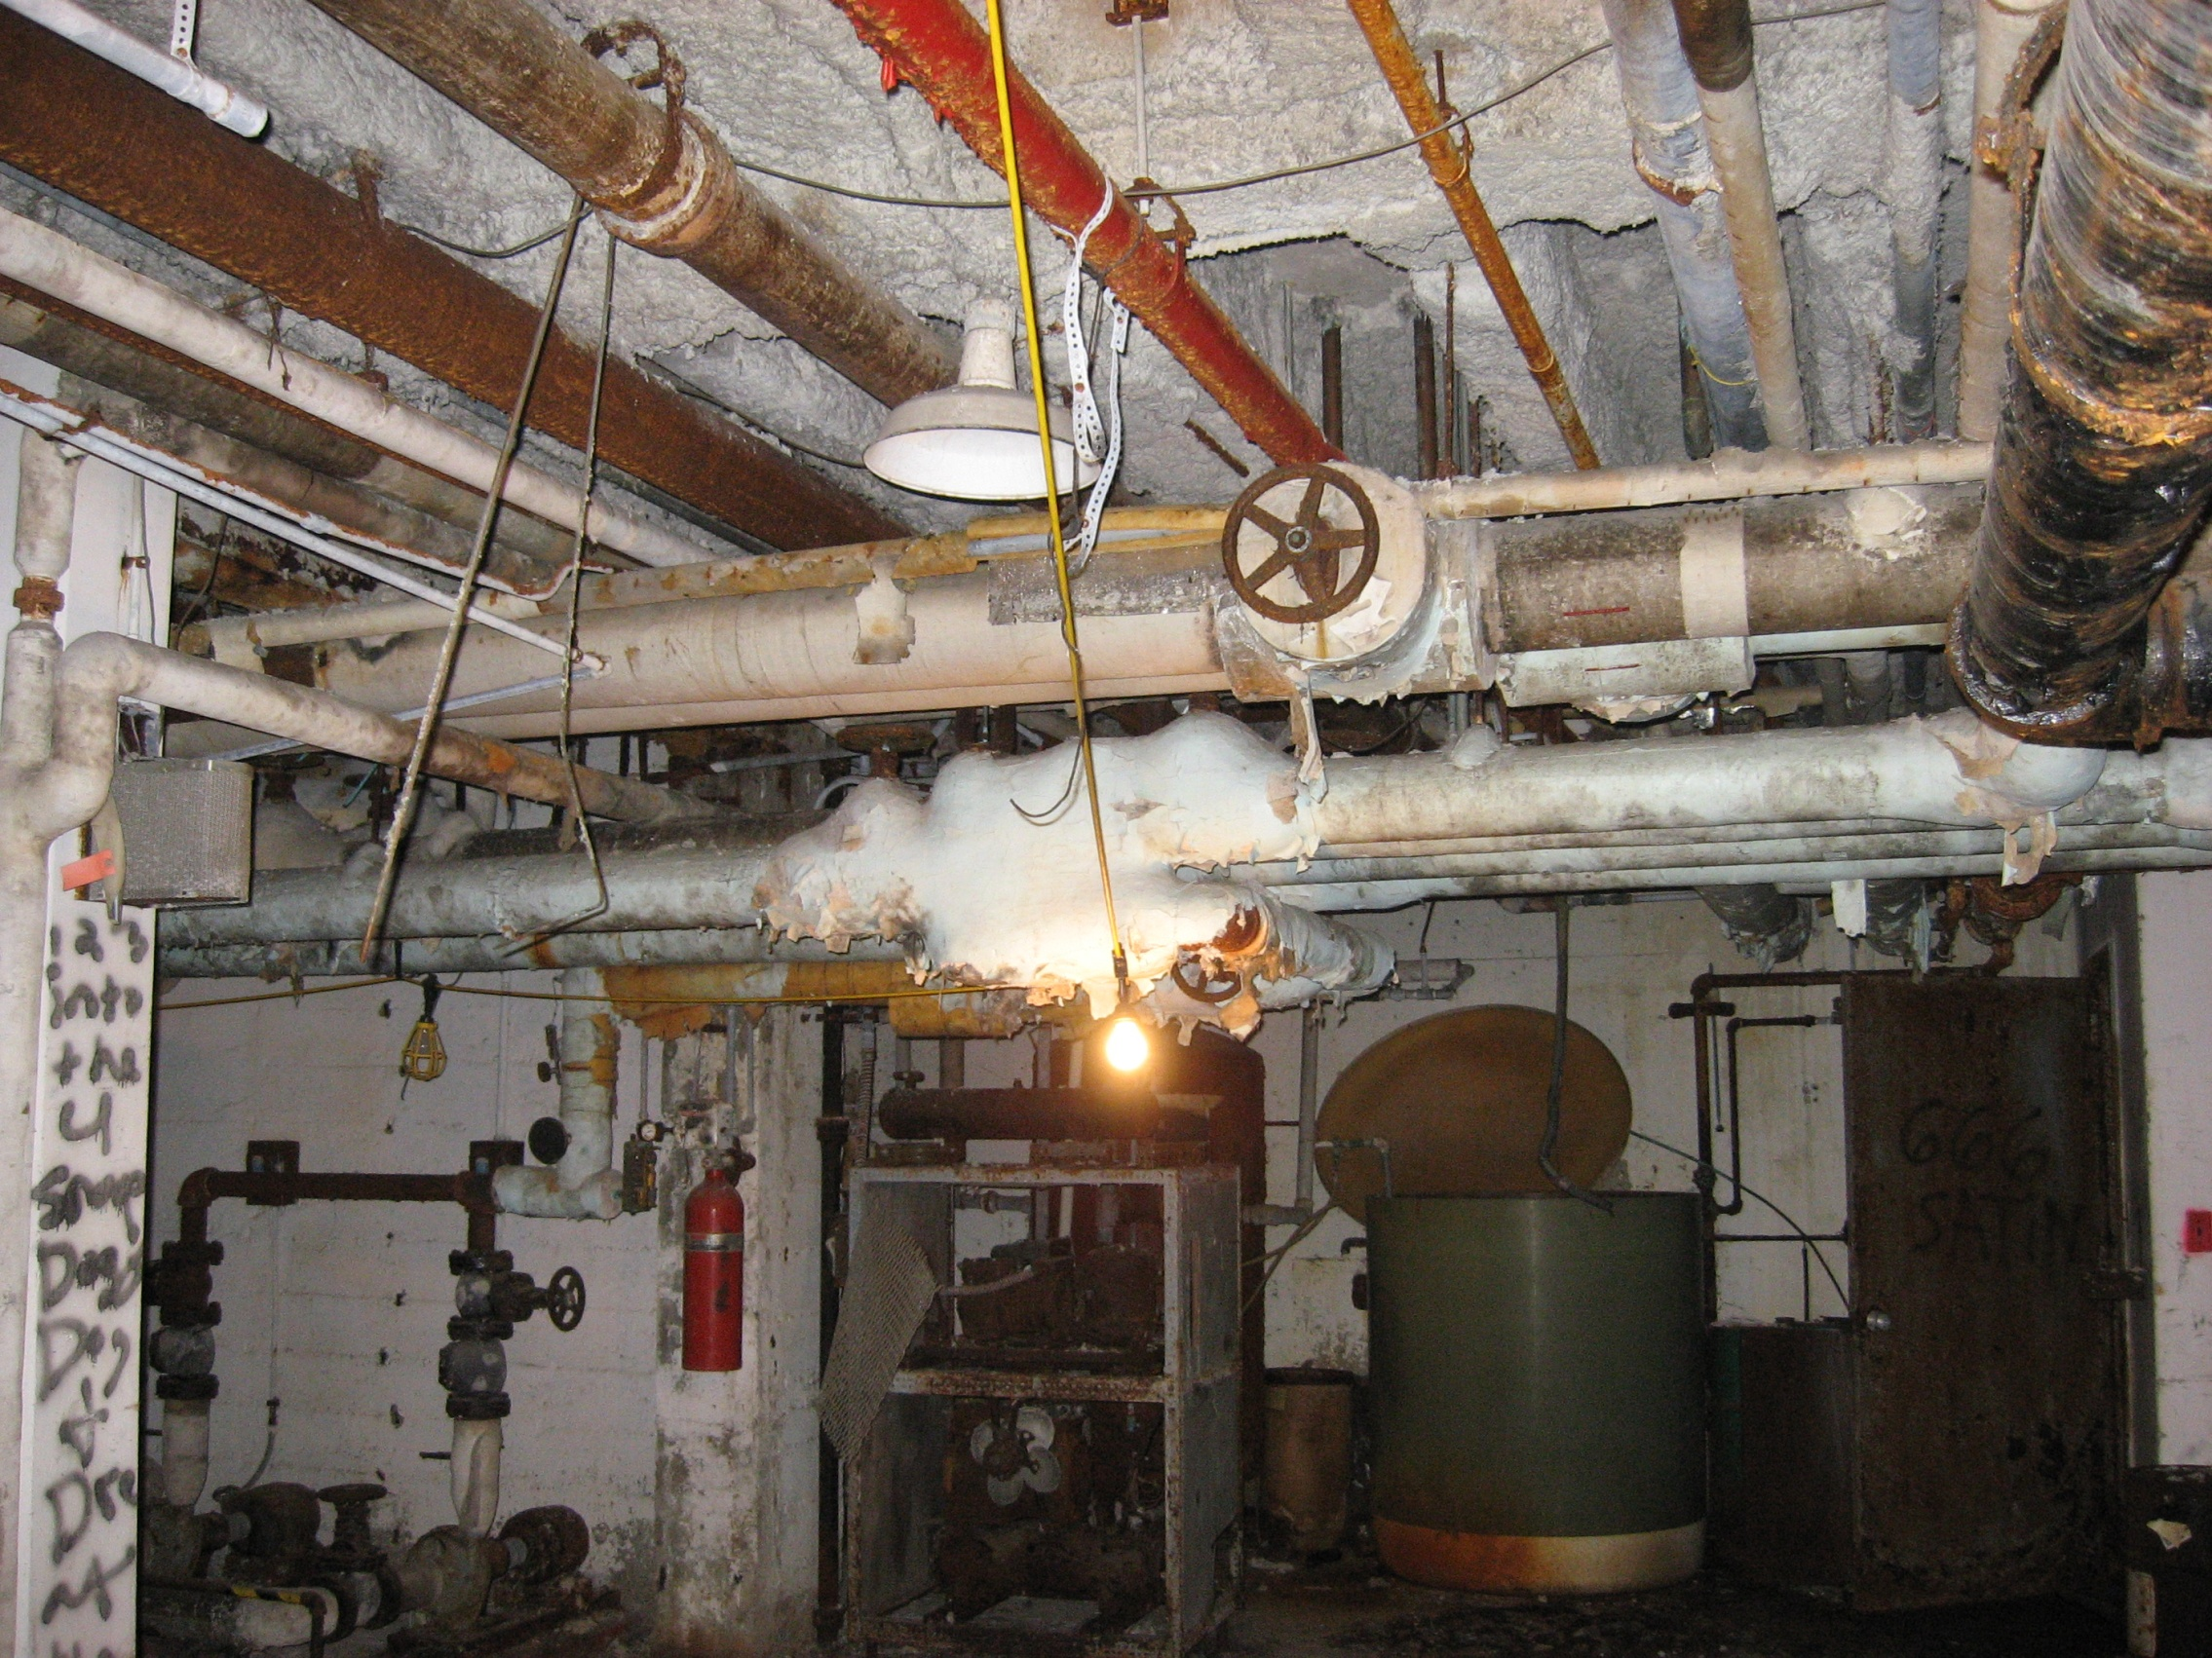
ASBESTOS

Slide 30
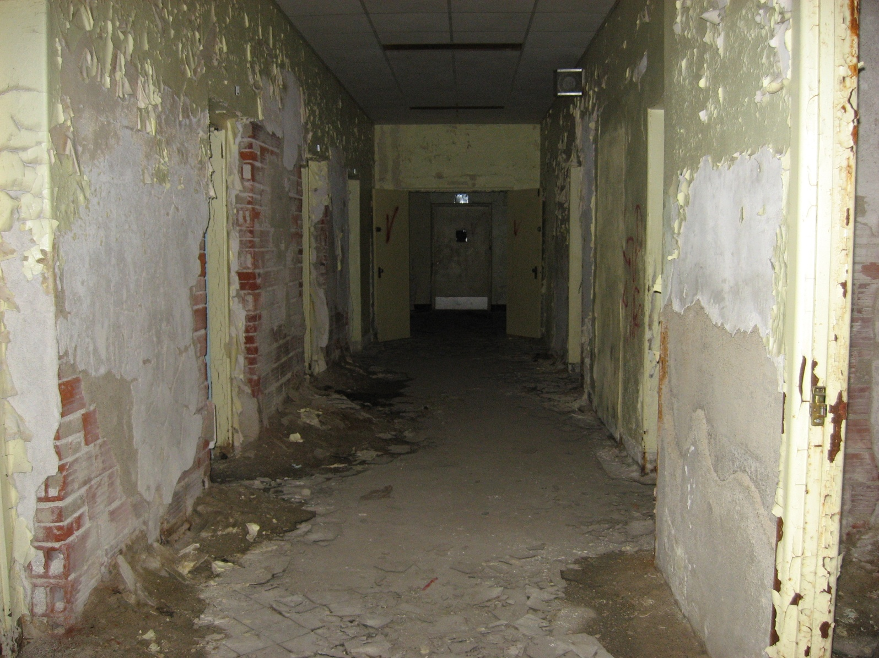
LEAD PAINT….

Slide 31
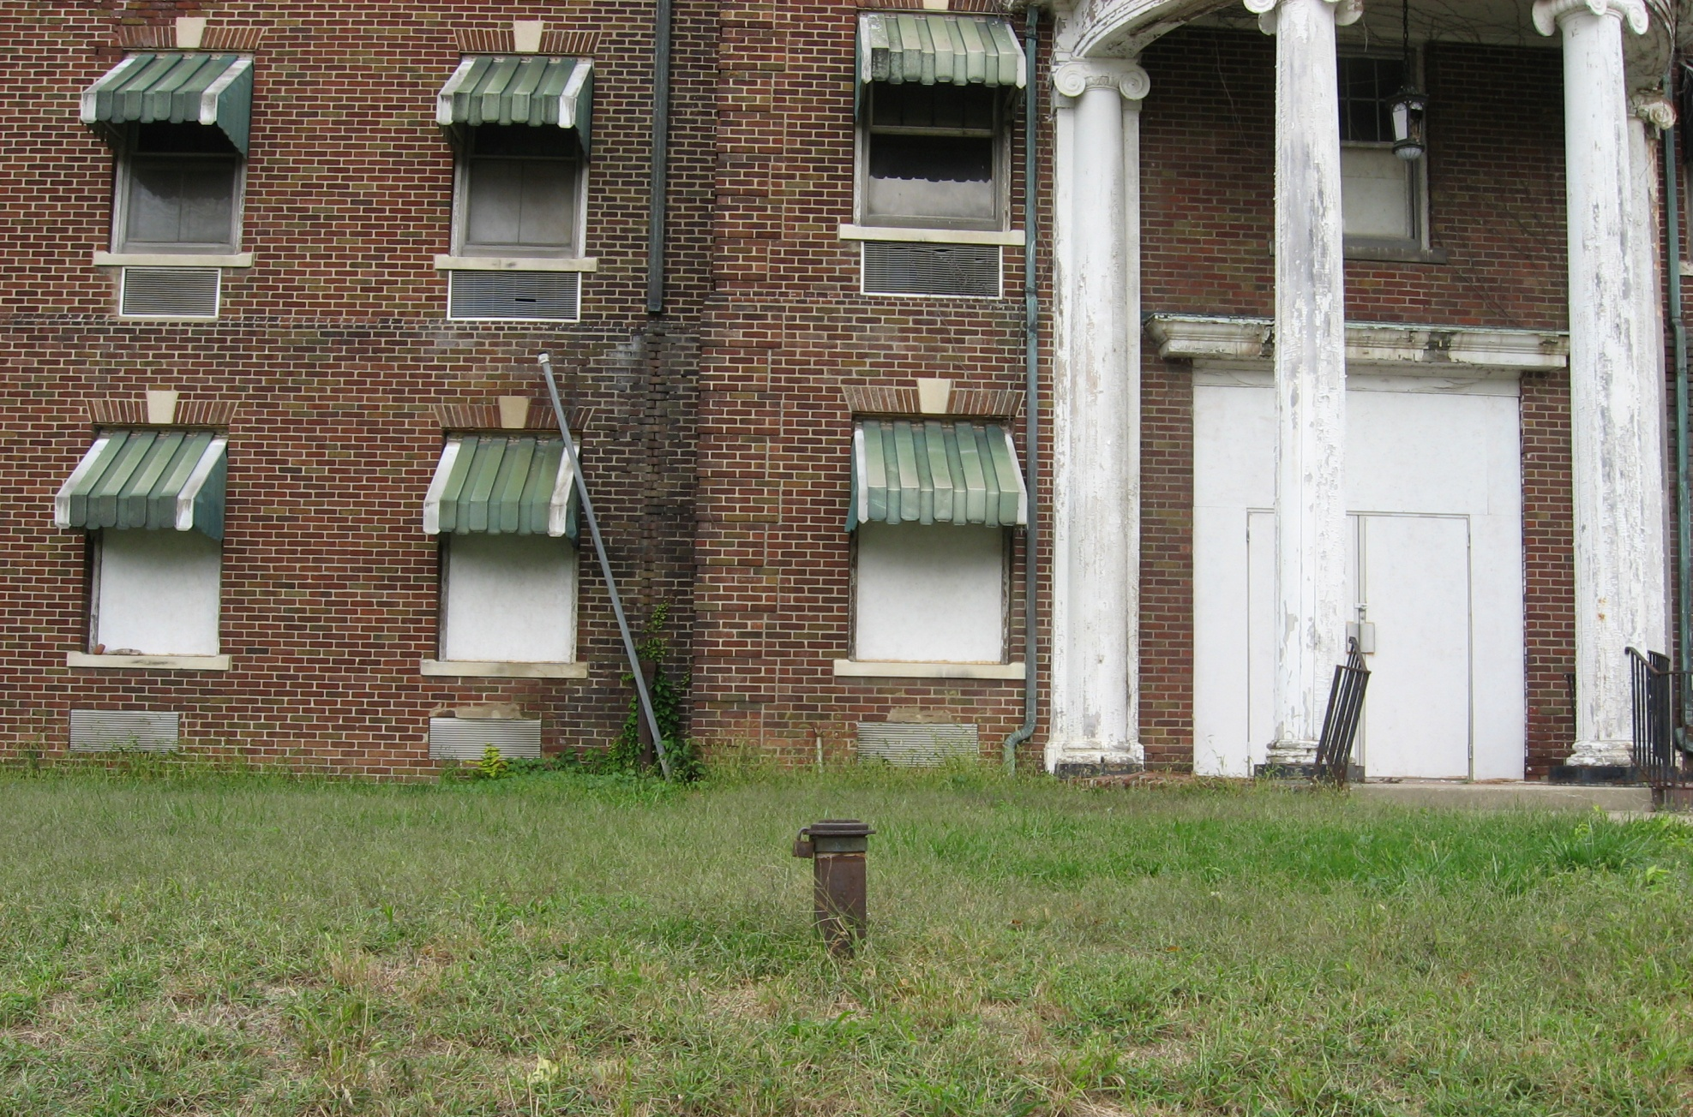
UNDERGROUND STORAGE TANK

Slide 32
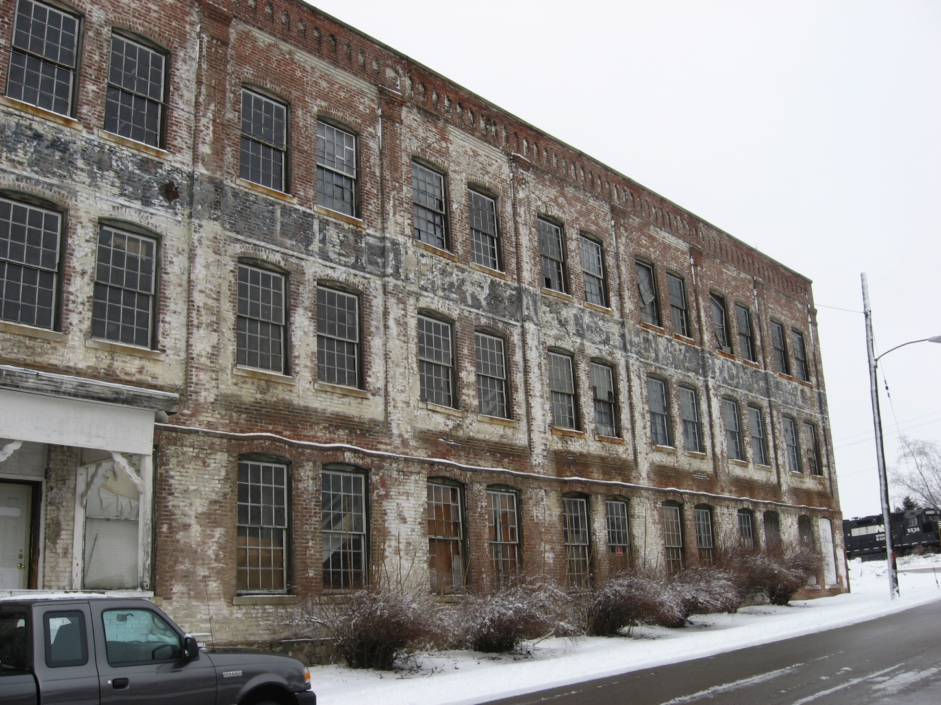
POTENTIAL FOR CONTAMINATION

Slide 33
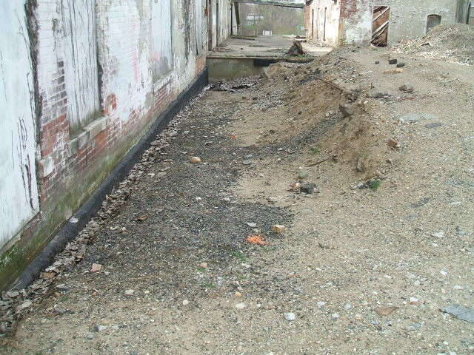
STAINED SOILS

Slide 34
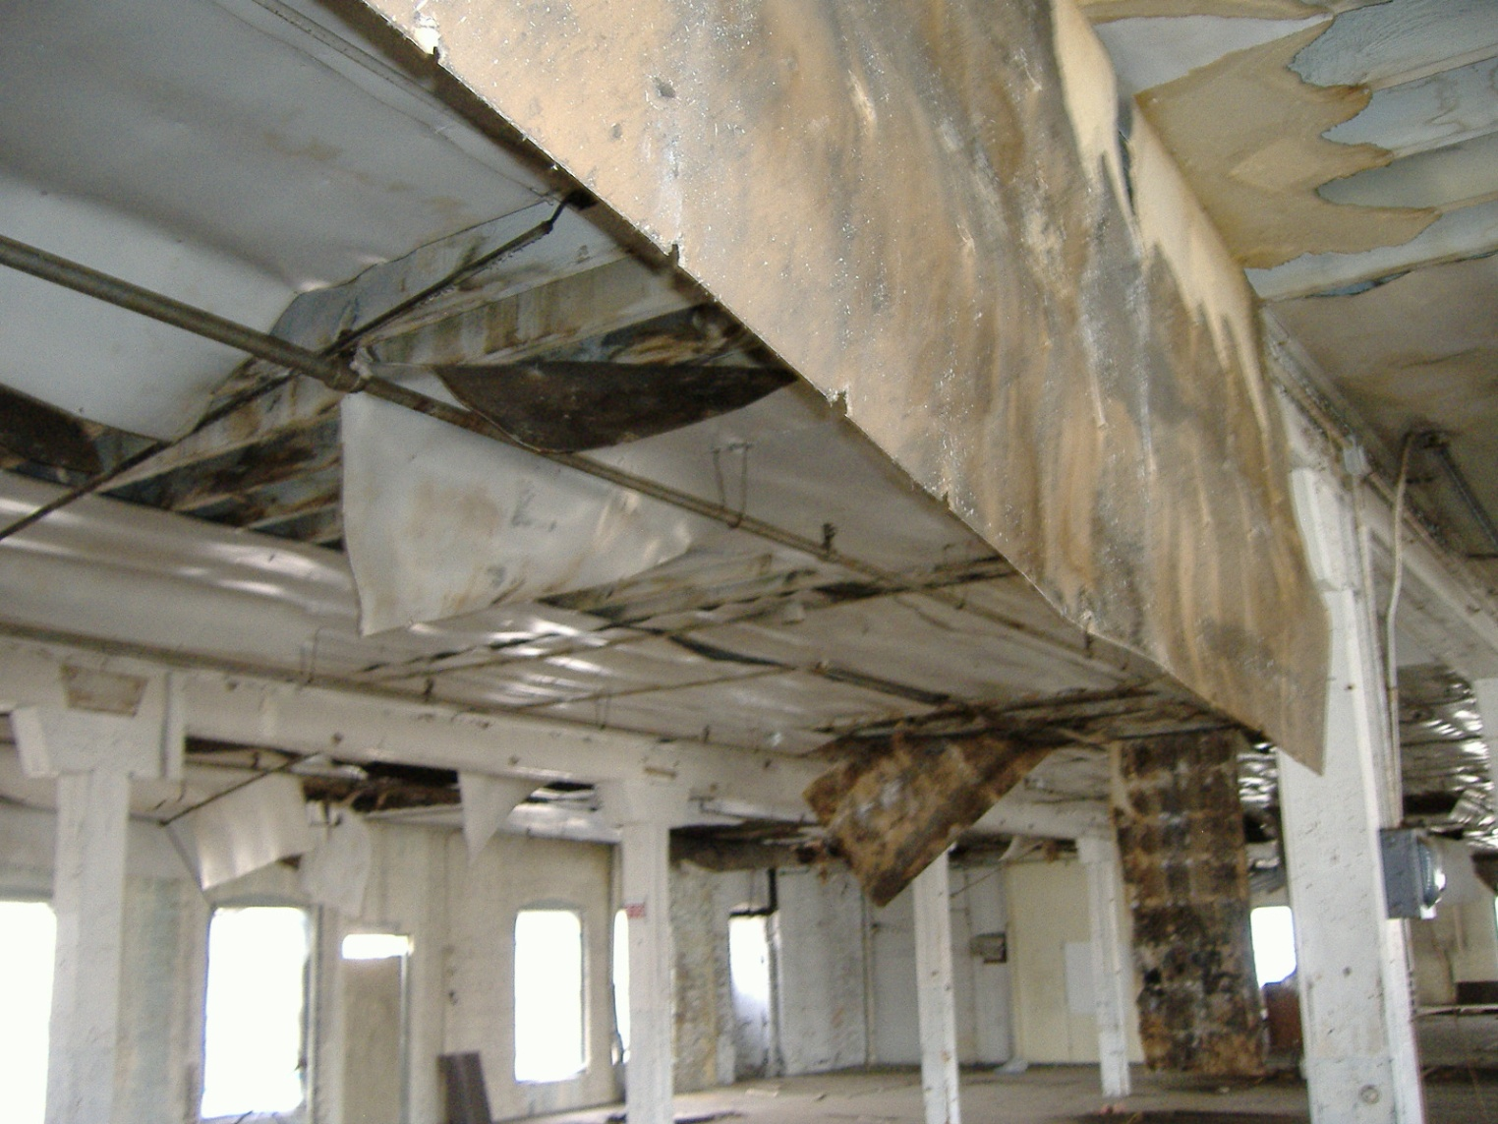
POTENTIAL FOR CONTAMINATION?

Slide 35
REMEMBER….BROWNFIELDS ARE
REAL PROPERTY
EXPANSION, REDEVELOPMENT OR REUSE
POTENTIAL TO CONTAIN
  CONTAMINATION

Slide 36
PRESENTED BY:
BETH A. GRIGSBY, LPG
BROWNFIELD PROGRAM MANAGER
ATC ASSOCIATES, INC
TAB SUBCONTRACTOR FOR INDIANA SERVICES:
KANSAS STATE UNIVERSITY TAB PROGRAM
beth.grigsby@atcassociates.com
1-800-488-2054
1-317-439-7871

