Slide 1
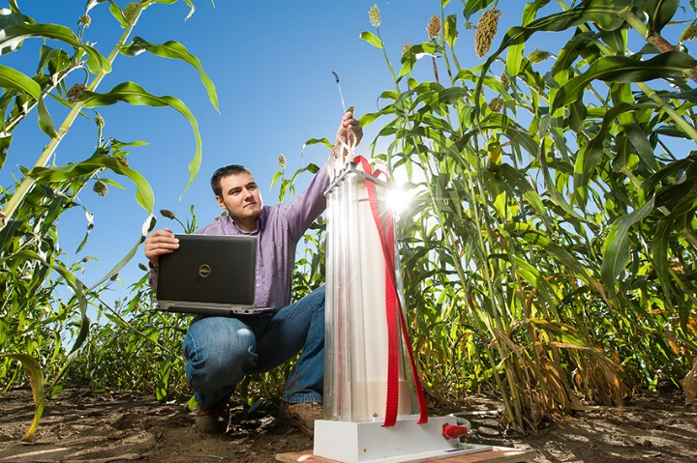
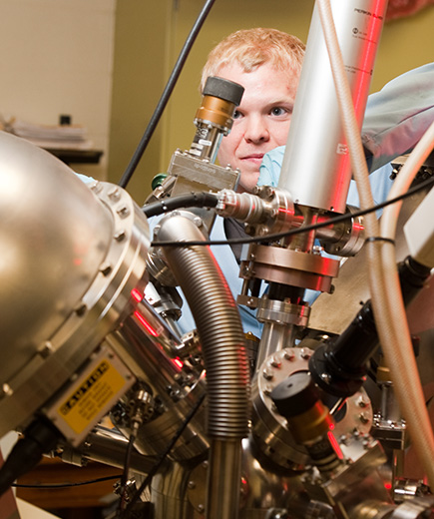
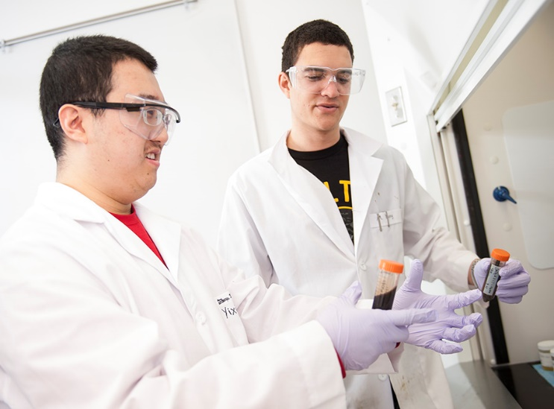
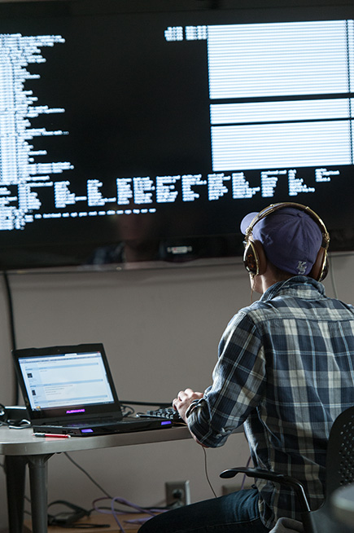
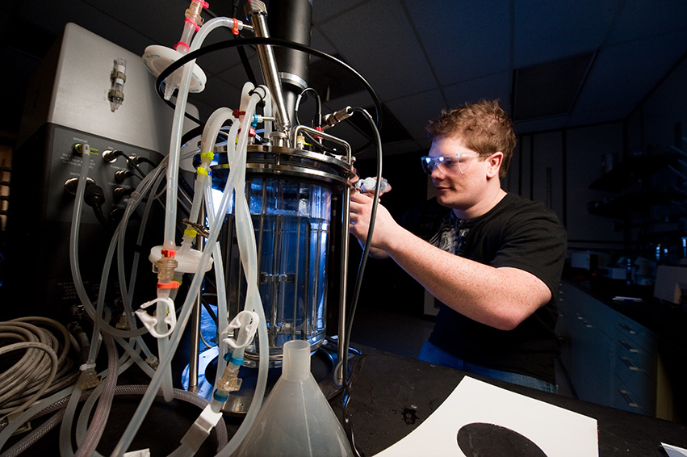
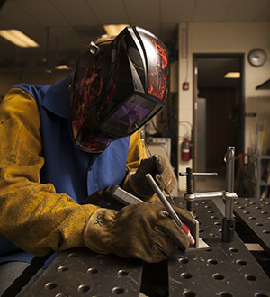
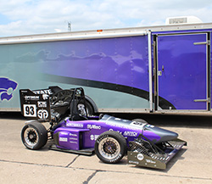
On Tenure

Slide 2
Opening Thoughts
Not about obtaining tenure
It is about
Becoming a dynamic faculty member
Making a significant impact
My advice
Focus on impact
Tenure will work itself out
Don’t worry about it

Slide 3
Opening Thoughts
Okay
Enough of the platitudes
Now I will tell you how to get tenure

Slide 4
Building a Research Program
Scholarship
Find out what the requirements are and make sure you are within them
While there is no substitute for high quality scholarship, all of your publications will not be at the same level
Balance between highly respected and second tier journals
Stay away from journals that lack the respect of your colleagues

Slide 5
Building a Research Program
Scholarship
Submit a list of suggested reviewers with every paper (reviewers that you know, and know you)
Use conferences and conference publications as a testing ground for new ideas
Use the preliminary program to determine what papers you will attend
Use the remaining time to network
Use the conference to generate new ideas for your own work
Learn to write and write well
You may need to sit in a writing course

Slide 6
Building a Research Program
Know the cognizant program managers in all agencies related to your success
NSF hit rates are below 10%
If your research program only consists of NSF submittals, you are swimming uphill
Attend the pertinent conferences that these program managers attend, and let them know what you are doing
Be willing to reinvent yourself
Take what you know and apply it to other areas
Stay ahead of the curve
Investigate new areas
Talk to people outside of your research area

Slide 7
Building a Research Program
Future research will be platform or application specific
Energy related research
environmental issues, resilience, sustainability
renewable energy, energy storage, smart grid
High Performance Computing
turbulence, combustion, astrophysics, geosciences
genomics, molecular dynamics, imaging, biomedicine
transportation, homeland security
Interdisciplinary Materials Research
biomaterials, photonic-based systems
materials exhibiting self-repair, diagnosis, and replication
Interdisciplinary Systems
biologically inspired systems, smart/intelligent systems
Think about how to leverage industrial related work

Slide 8
Building a Research Program
Building a strong reputation
People must know you
No reputation is worse than a controversial one
The easiest way to become known is to work for it
Join a societal technical committee related to your research area and volunteer for something
Ask successful people if they need help and help them!
Spend at least one summer somewhere else (e.g., national labs, other universities, etc.)
Use your local network to give invited talks

Slide 9
Students
Students are extremely important to your success
Interview potential students
Go beyond their undergrad university and GRE
Make sure their research interests truly fit your own
Ask questions
“What have you done that highlights your interests?”
Develop students from the undergrad level
Trade with faculty from other universities
Look for the fire in the belly

Slide 10
Teaching
Teaching is important but it is binary
Teaching is the one common thing
If you are exceptional in teaching, it helps
If you are a poor teacher, it hurts
Good teaching creates good students at all levels
Try to fuse your teaching and research
You learn best by teaching!
Develop or teach courses in your research area
Bring research examples into the class
Hire undergrads to build demonstrations or simulations for classes at all levels

Slide 11
Final Thoughts
Final Thoughts
Develop 5 ways to respectfully say NO
If you are doing what you are supposed to do,
you are successful, and
you are having problems,
tell us so we can work on solutions
Find good mentors and use them
Your best mentors are close by
But you should have mentors from all walks of life
Utilize the wealth of people that are around you

Slide 12
Behind the Curtain: A Typical TPR Discussion
Later You Will Be Able to Relax & Walk More Slowly
Question: Do untenured faculty walk faster than other faculty?

Slide 13
Here Is What the Study Revealed
Later You Will Be Able to Relax & Walk More Slowly
Subtitle

Slide 14
Later You Will Be Able to Relax & Walk More Slowly
Later You Will Be Able to Relax & Walk More Slowly
Subtitle

Slide 15
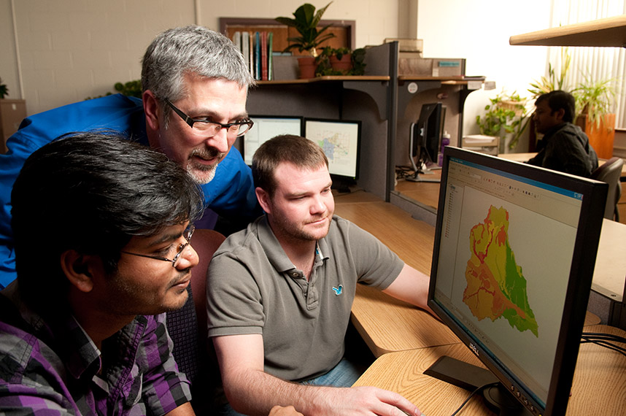
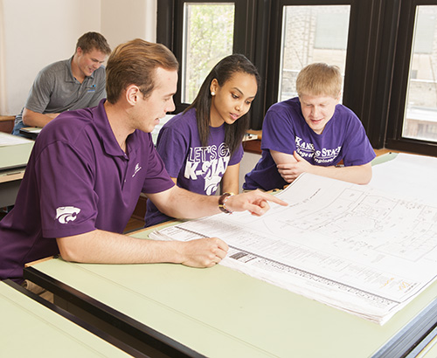
Thank You!

