Slide 1
ABET Assessment Overview
December 11, 2019

Slide 2
OVERVIEW OF ABET AND PROCESS
Accreditation process and cycle
Criterion + APPM
Self-Study
Site visit

Slide 3
DEFINITIONS
Program Educational Objectives Program educational objectives are broad statements that describe what graduates are expected to attain within a few years of graduation. Program educational objectives are based on the needs of the program’s constituencies.
Student Outcomes Student outcomes describe what students are expected to know and be able to do by the time of graduation. These relate to the knowledge, skills, and behaviors that students acquire as they progress through the program.

Slide 4
DEFINITIONS
Assessment Assessment is one or more processes that identify, collect, and prepare data to evaluate the attainment of student outcomes. Effective assessment uses relevant direct, indirect, quantitative and qualitative measures as appropriate to the outcome being measured. Appropriate sampling methods may be used as part of an assessment process.
Evaluation Evaluation is one or more processes for interpreting the data and evidence accumulated through assessment processes. Evaluation determines the extent to which student outcomes are being attained. Evaluation results in decisions and actions regarding program improvement.

Slide 5
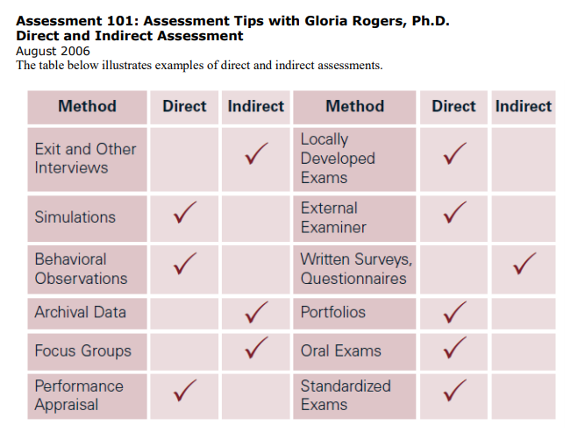
Direct and Indirect Assessment

Slide 6
Criterion 2. Program Educational Objectives (CAC)
The program must have published program educational objectives that are consistent with the mission of the institution, the needs of the program’s various constituencies, and these criteria. There must be a documented, systematically utilized, and effective process, involving program constituencies, for the periodic review of these program educational objectives that ensures they remain consistent with the institutional mission, the program’s constituents’ needs, and these criteria.
Criterion 2. Program Educational Objectives (EAC)
The program must have published program educational objectives that are consistent with the mission of the institution, the needs of the program’s various constituencies, and these criteria. There must be a documented, systematically utilized, and effective process, involving program constituencies, for the periodic review of these program educational objectives that ensures they remain consistent with the institutional mission, the program’s constituents’ needs, and these criteria.

Slide 7
Criterion 3. Student Outcomes (CAC)
The program must have documented and publicly stated student outcomes that include (1) through (5) below and any outcomes required by applicable Program Criteria. The program may define additional outcomes.
Graduates of the program will have an ability to:
Analyze a complex computing problem and to apply principles of computing and other relevant disciplines to identify solutions.
Design, implement, and evaluate a computing-based solution to meet a given set of computing requirements in the context of the program’s discipline.
Communicate effectively in a variety of professional contexts.
Recognize professional responsibilities and make informed judgments in computing practice based on legal and ethical principles.
Function effectively as a member or leader of a team engaged in activities appropriate to the program’s discipline.

Slide 8
Criterion 3. Student Outcomes (EAC)
The program must have documented student outcomes that support the program educational objectives. Attainment of these outcomes prepares graduates to enter the professional practice of engineering. Student outcomes are outcomes (1) through (7), plus any additional outcomes that may be articulated by the program.
an ability to identify, formulate, and solve complex engineering problems by applying principles of engineering, science, and mathematics
an ability to apply engineering design to produce solutions that meet specified needs with consideration of public health, safety, and welfare, as well as global, cultural, social, environmental, and economic factors
an ability to communicate effectively with a range of audiences
an ability to recognize ethical and professional responsibilities in engineering situations and make informed judgments, which must consider the impact of engineering solutions in global, economic, environmental, and societal contexts
an ability to function effectively on a team whose members together provide leadership, create a collaborative and inclusive environment, establish goals, plan tasks, and meet objectives
an ability to develop and conduct appropriate experimentation, analyze and interpret data, and use engineering judgment to draw conclusions
an ability to acquire and apply new knowledge as needed, using appropriate learning strategies.

Slide 9
Criterion 4. Continuous Improvement (CAC)
The program must regularly use appropriate, documented processes for assessing and evaluating the extent to which the student outcomes are being attained. The results of these evaluations must be systematically utilized as input for the continuous improvement of the program. Other available information may also be used to assist in the continuous improvement of the program.
Criterion 4. Continuous Improvement (EAC)
The program must regularly use appropriate, documented processes for assessing and evaluating the extent to which the student outcomes are being attained. The results of these evaluations must be systematically utilized as input for the continuous improvement of the program. Other available information may also be used to assist in the continuous improvement of the program.

Slide 10
EAC SO#1: an ability to identify, formulate, and solve complex engineering problems by applying principles of engineering, science, and mathematics
Problem solving must address complex problems (SO#1)
Complex Engineering Problems – Complex engineering problems include one or more of the following characteristics: involving wide-ranging or conflicting technical issues, having no obvious solution, addressing problems not encompassed by current standards and codes, involving diverse groups of stakeholders, including many component parts or sub-problems, involving multiple disciplines, or having significant consequences in a range of contexts.
Only one of the above characteristics is needed.
Programs have freedom to choose where they assess and evaluate complex problems.

Slide 11
EAC SO#1: an ability to identify, formulate, and solve complex engineering problems by applying principles of engineering, science, and mathematics
Criteria and Performance Indicators
HW assignment of a complex problem.
Problem statement shows understanding of the problem. Could use a simple rubric for assessing understanding of the problem statement
Problem solution is appropriate and within reasonable constraints. Use a solution rubric to assess answers and if within limits.
Capstone report is used to “Applies mathematical principles to achieve analytical or numerical solution to model equations.”
Use a basic analysis rubric to assess level of understanding and skill

