Slide 1
Working with Industry
Executive Summary
Paul Lowe – Office of PreAward Services Chris Brandt – K-State Research Foundation
October 10, 2018

Slide 2
Working With Industry
K-State Success Story by the Numbers
291 New Projects funded by industry in FY2018
20% increase in corporate funded projects FY18, 80% increase over last 5 years
Received $27.8Min industry funding in FY2018
4th straight year of record invention disclosures

Slide 3
Working With Industry
K-State Success Story by the Numbers
Negotiated and executed 21 new Corporate funded Master Research and Service Agreements in FY2018 and executed 3 additional MRSA with industry focused commodity groups and consortiums
K-State now has over 55 active MRSAs with industry with 5 more under negotiation
Increased industry participation in site visits and Research Showcase activities

Slide 4
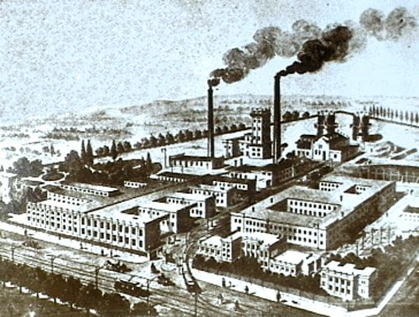
The Modern University – How We Have Opened the Doors for Collaboration
19th Century: Competence Factory
13th Century: Scholarly Warehouse
Now: Innovation Hubs
What is Innovation?
Research is the transformation of money into knowledge.
Innovation is the transformation of knowledge into money.
-Dr. Geoffrey Nicholson, 3M
(Inventor of the Post-it note)

Slide 5
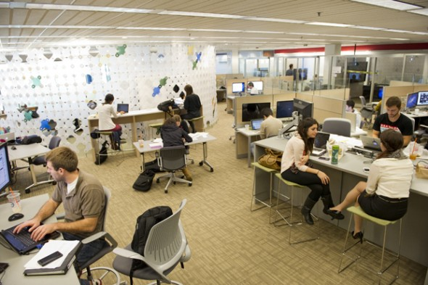
How Industry Sees the Modern Research University
Future Workforce
Advanced Laboratories
Continuing Education
Thought Leadership
Startups and Spinouts
Intellectual Property
Most companies attempt to engage with universities through multiple entry points across a partnership continuum.

Slide 6
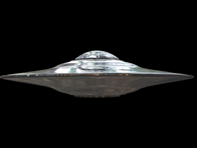
How Universities Sees Industry
Why Are You Here?
Do we speak the same language?
Where is the door?
What Is going on in Your Ship?
Will You Take Our Students With You?
Take Me To Your Research

Slide 7
Working With Industry – Understanding Our Cultural Differences

Slide 8
Working With Industry – Understanding Our Cultural Differences
Notes:
Business Needs or Consumer

Slide 9
Working With Industry – Understanding Our Cultural Differences

Slide 10
Working With Industry – Understanding Our Cultural Differen

Slide 11
Match.comedu
Institutional Perspective…
Leverage personnel, institutional and business networks to find contacts
Market your expertise in various media as well as publishing and being active at conferences
Make yourself easy to find
Websites, Podcasts, Social Media (Facebook, Twitter, LinkedIn)
Industry Perspective….
Use multiple mechanisms for finding the right contact….
Internet searches
Networking
Request for proposals
Conference attendance
External matchmaking services
How can I find companies to fund my lab?
How do I make a connection?
How can we innovate to beat our competition?
How do I solve this immediate problem?

Slide 12
Develop an Engagement Profile
Research companies and industries
Hoover’s and other corporate databases
Job postings
Press releases
Web content/internet searches
Government contract awards
Conference publications
Patent filings
Develop a quad chart introducing your lab (i.e. graphical elevator speech) tailored to innovation needs identified during your discovery work

Slide 13
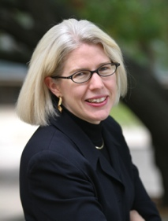
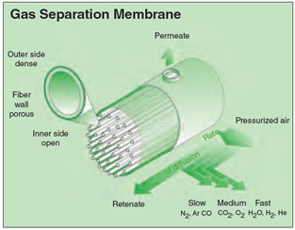
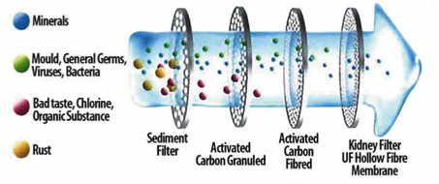
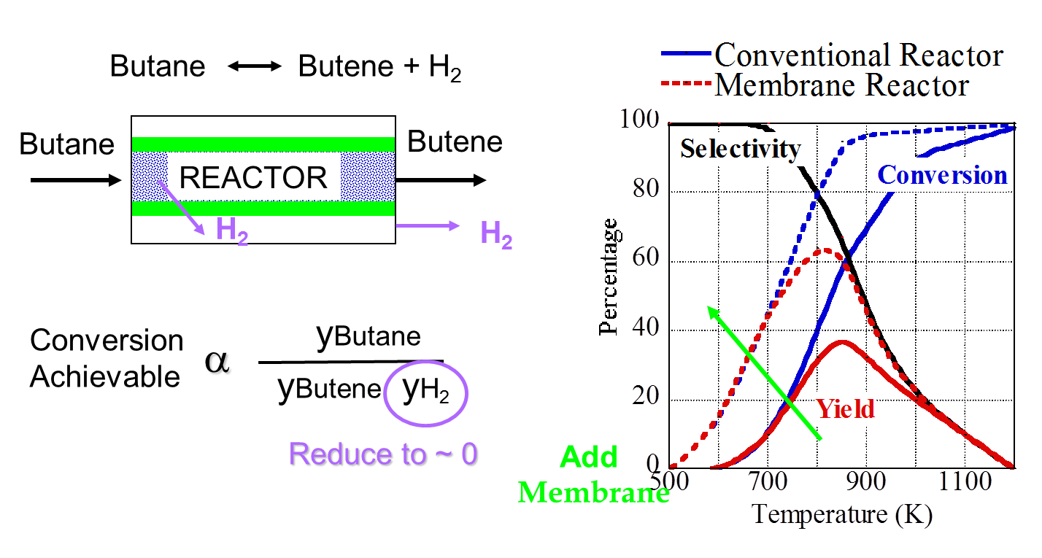
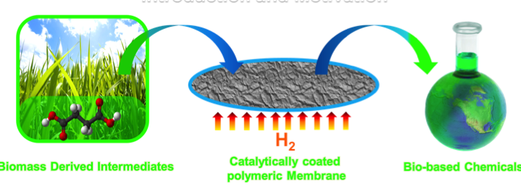
Mary Rezac, Chemical Engineering, Phillips 66 Professor of Sustainable Energy, rezac@ksu.edu
Academic / Industrial Experience
BS 1987 Kansas State University Chemical Engineering
MS/PhD 1992/3 University of Texas Chemical Engineering
Research Engineer, Phillips Petroleum, Bartlesville, OK, 1987-90
Assist & Assoc Professor (with tenure), Chemical Engineering , Georgia Tech, 1994 – 2002
Professor/Depart Head, Chemical Engineering, K-State, 2002-
Director, Center for Sustainable Energy, K-State , 2007-
Research Interests
Polymeric Membranes for Gas and Liquid Separation with enhanced chemical and thermal stability
Design of Membrane Contactors for:
Selective Removal of Reaction Product to shift equilibrium
Selective addition of reactant to simplify process or promote product selectivity
Selected Industrial Applications
Laboratory Capabilities
Analytical: GCs, HPLCs, GC-MS with CDS Pyroprobe, Karl Fisher, CHNS analysis, IKA Calorimeter
Reactors: Bench to small pilot scale Parr systems (6); Packed Bed systems (multiple), CSTRs (multiple)
Membrane Characterization: Constant Pressure-Variable Volume Systems (8), Constant Volume Variable Pressure Systems (6). Pressures to 20 atm, Temperature to 300 °C
Materials Characterization: Density Gradient Column; Gas Sorption, Vapor Sorption, BET surface area, WAXD
Research Sponsors

Slide 14
You’ve identified a possible connection – Do Your Homework
Spend time learning about the industry partner’s strategic objectives (review past and current partnering experiences mentioned on websites)
Note: these may not be easy to find. Look for publicly available presentations, quarterly reports, other U-I partnerships, company owned patent applications, etc)
Determine if anyone else is publishing (or patenting) in the area of research important to the company
KSURF for patent data; PreAward Services for company funding activities
Identify matches between your strengths/company’s objectives
In early relationships, narrow your focus and be specific to match (i.e. rifle vs. shotgun approach)
Customize your quad chart to focus on company’s needs and objectives

Slide 15
Working With Industry – Relationship Turn Ons and Turn Offs
“We have a lot of smart people and world class equipment”
(So does every other university)
“I’m famous”
(Industry desires fresh ideas, i.e. just received tenure – new ideas, new energy, more flexibility)
“Just give us a million dollars over 10 years and we will solve your problems”
(Transactional vs. strategic)
“First, tell us all your problems”
(Company problems are trade secrets)
“Let me tell you how to manage your IP portfolio”
(Universities are not experts in company’s marketplace)
The “Tech-splainer”

Slide 16
Working With Industry – Relationship Turn Ons and Turn Off
Background IP can be a bit of a turn off
Cautionary tale: Beware of filing a provisional patent right after meeting with an industrial partner, whether an NDA is in place or not
Most companies have little to no interest in IP if they feel they can be “held for ransom”

Slide 17
Working With Industry – Understanding Our Cultural Differences
Be confident, but honest about your capabilities (don’t over sell it – “under promise, over deliver”
(Companies are not technically intimidated)
Understand and leverage your real strengths, using benchmarking if possible
(ID what sets you apart from others – 100’s working on batteries, why are you different?))
Understand the timeline and fiscal year constraints of the company you are working with (annual budget approval vs. 3-4 yr graduate student career)

Slide 18
Working With Industry – Ingredients for a successful partnership
Scope
Time
Quality
Cost
Industry Requirement (End User/Customer Need)
Technical Solution (R&D, Product development or testing)
Faculty Interest & Expertise (Students, Time, etc.)
Funding (Industry, Federal, Joint, etc.)
Contract Mechanism (streamlined)
Decision Authority (executive sponsor)
All Ingredients are required
Good
Cheap
Fast
Pick Any Two!

Slide 19
Working With Industry – Ingredients for a successful partnership
90% of success is communication
Who, What, When, Where, Why and How
Clear, Complete, and well understood messaging
Manage expectations
It doesn’t stop when the deal is closed
Minimize disputes and objective creep with careful evaluation and mutual agreement on project SOW
Discuss potential points of failure or setback, discuss mitigation plans to overcome obstacles
Include contracting office early on for contract terms discussion

Slide 20
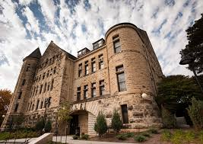
The Capture Process
The Role of the Office of PreAward Services……….
Initial Opportunity –
Confidentiality Agreements
Material Transfer Agreements
Teaming Agreements
IP and Data Sharing/Use Agreements, etc.
(Referred to locally as $0 Agreements)
http://www.k-state.edu/research/leadership/preaward/

Slide 21
The Capture Process
The Role of the Office of PreAward Services……….
Funding Agreements –
Memorandums of Agreement
Subcontracts off of Prime Contracts
Research Agreements, etc.
Public Policy Mandates and University Policy Drives K-State’s Negotiation Agenda – Not Preferred Strategic Positioning

Slide 22
The Capture Process
Working with Industry WATCHOUTS:
What overhead will my company be required to pay?
What is your IP policy?
What Agreement Should Be Used?
Can I Send Industry a Budget?
If budget is required, see budget development tool: http://www.k-state.edu/research/faculty/proposal/budgets/
Scope Creep?
Are Timelines and Milestones Realistic?

Slide 23
Working with Industry Myths
MYTH
FACTS
You Can’t Publish if you are Working with Industry
PreAwards will protect your right to publish
Companies usually agree to language stating that they will have prior review of any publication for protection of company-owned Confidential Information and/or patentable subject matter

Slide 24
Working with Industry Myths
MYTH
FACTS
Researchers Can’t Continue Research Programs if they Work with Industry
Companies want access to research, not to own a researcher
PreAwards knows that research programs are the lifeblood of any faculty member and will protect the ability of researchers to continue their work

Slide 25
Working with Industry Myths
MYTH
FACTS
Industry Sponsored Research is biased and not valuable
Most Companies want unbiased results from a University to make any claims to positive results more valuable

Slide 26
Working with Industry Myths
MYTH
FACTS
Industry Sponsored Research is Confidential
Company-sponsored research generally has confidentiality obligations, however, generally the entire project isn’t confidential and results can be published with the company’s prior review

Slide 27
INTELLECTUAL PROPERTY QUICK GUIDE
Why would industry want to work with Universities?
Special Facilities?
Expertise?
Access to great students?
Potentially valuable Intellectual Property?

Slide 28
INTELLECTUAL PROPERTY QUICK GUIDE
Intellectual Property (“IP”) Rights are a form of property which is intangible yet can often be quite valuable
Principle Forms of IP
Patents
Copyrights
Trademarks
Trade Secrets

Slide 29
INTELLECTUAL PROPERTY QUICK GUIDE
What is a Patent?
Invention - must be a new technical solution or improvement to a product or process
Rights – government grant to exclude others from making, using, importing, selling or offering to sell a claimed invention
Term - 20 year monopoly exchanged for detailed public disclosure of an invention

Slide 30
INTELLECTUAL PROPERTY QUICK GUIDE
What is an Invention? – something that is new and non-obvious
What’s Non-obvious? – Anything that one of ordinary skill would not have expected
Bottom Line: The hurdle is lower than you think

Slide 31
INTELLECTUAL PROPERTY QUICK GUIDE
When is something unexpected?
When you expect something to go up but it goes down.
When you expect something to go up but it goes way, way up.
When you expect something to go up but it doesn’t
When you expect something to happen but nothing happens
When you expect nothing to happen but something happens

Slide 32
INTELLECTUAL PROPERTY QUICK GUIDE
How much proof do you need?
NONE! (Unless you need to overcome the prior art)
If you are using a known component in a composition, then you need to show that your type or amount of the component is unexpected.
For example, if it is known that adding silver to an alloy makes the alloy a better electrical conductor, you need experimental evidence to show that a surprising lower amount of silver increases the alloy’s conductivity.
It is easier if you know the prior art.

Slide 33
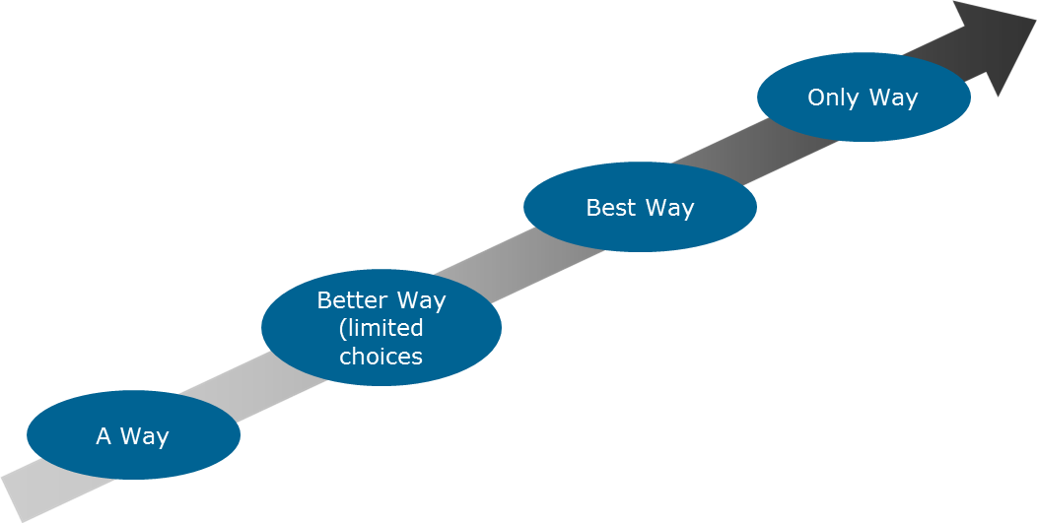
INTELLECTUAL PROPERTY QUICK GUIDE
How does a Patent give a Company Competitive Advantage?
Value – when there are fewer substitutes, a company can charge a premium

Slide 34
INTELLECTUAL PROPERTY QUICK GUIDE
What Does Industry Want?
They want you to solve problems and develop new technology.
They want you to tell them when you develop new technology.
They want the first right to license any new technology that is developed.
They DO NOT want their competitors to have access to anything valuable.

Slide 35
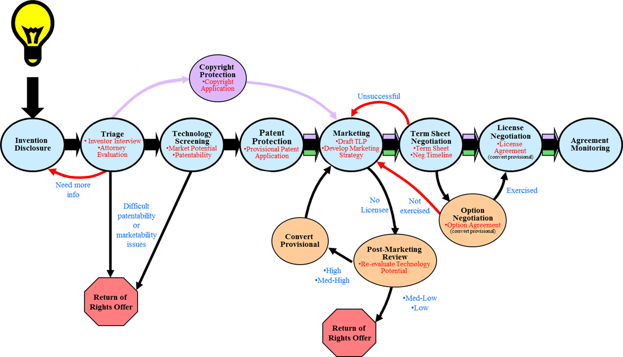
INTELLECTUAL PROPERTY QUICK GUIDE
Simplified Commercialization Process
__________________, Contracts Specialist

Slide 36
INTELLECTUAL PROPERTY QUICK GUIDE
Simplified Commercialization Process
Sponsored Research Agreement
Invention/Disclosure
IP Assessment
Protection
Commercialization
Check out:
www.k-state.edu/ksurf
__________________, Contracts Specialist

Slide 37
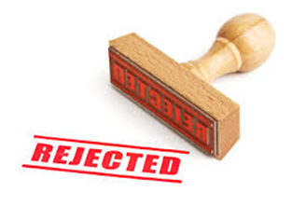
INTELLECTUAL PROPERTY QUICK GUIDE
Common Inventor Mistakes
*Public Disclosure
Blinded by Love
Did not do Homework
Waiting for Perfection
Didn’t Read the Contract
Fiscal Limits

Slide 38
INTELLECTUAL PROPERTY QUICK GUIDE
Public Disclosures
Publications can include
Abstracts
Poster presentations
Published grant applications
Other non-confidential disclosures
even a YouTube™ video
You can Patent and Publish!

Slide 39
CONTACT INFORMATION
Chris Brandt – KSURF
Email: brandtcd@ksu.edu
Phone: (785) 532-3919
Paul Lowe – PreAward Services
Email: plowe@ksu.edu
Phone: (785) 532-6804

